Slide 1
LO: To learn all about Anglo Saxon Gods and Religion.

Slide 2
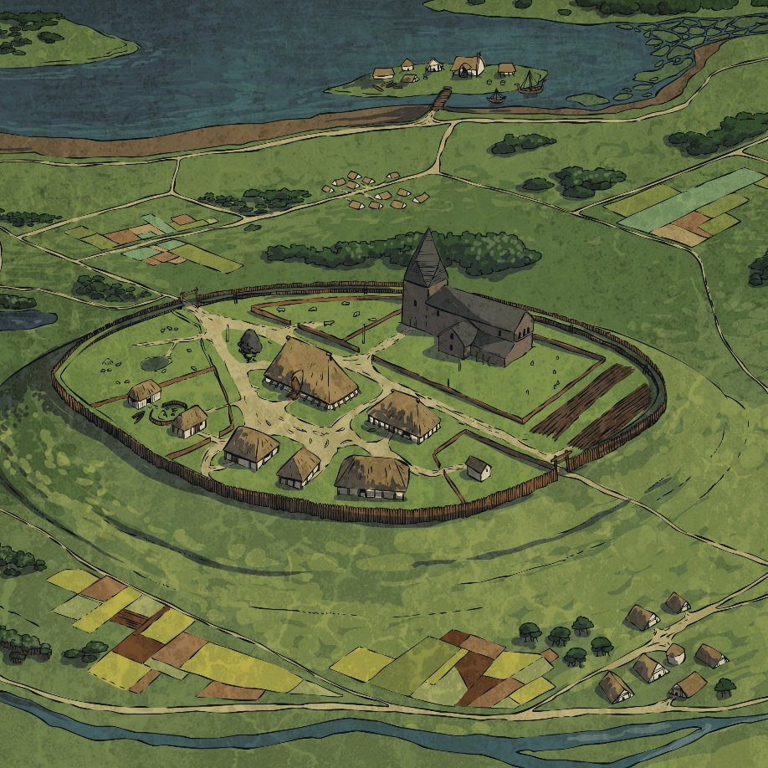
Where Did the Anglo-Saxon Gods Come From?
After the Romans left Britain, the Anglo-Saxons (Angles, Saxons and Jutes) arrived across the North Sea from Germany, Denmark and the Netherlands and with them came beliefs rooted in Norse mythology.
In the Norse legends, there were two groups of gods, whom the Anglo-Saxons called Ese and Wena. In time, Ese won over the Wena and the Ese became the rulers over the Wena.
The leader of the Ese, Woden, became King of all the gods.

Slide 3
Where the Anglo Saxons first came to Britain, they had lots of different gods. Our days of the week are names after these gods.

Slide 4
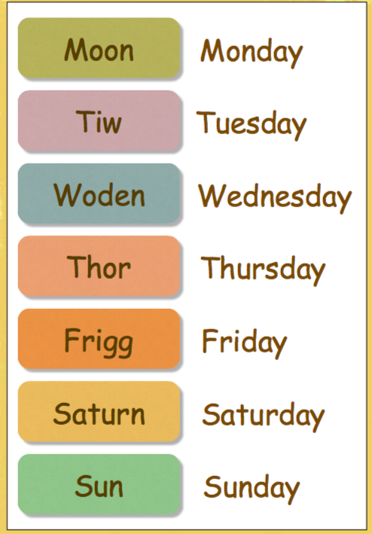
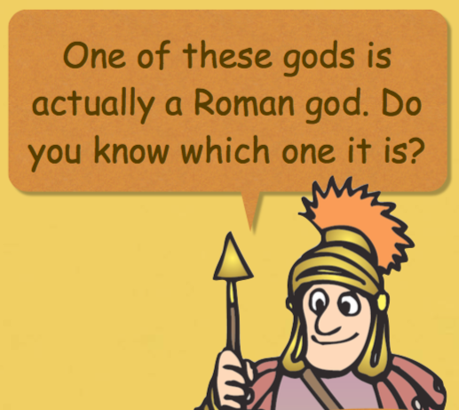
Did you match them all correctly?

Slide 5
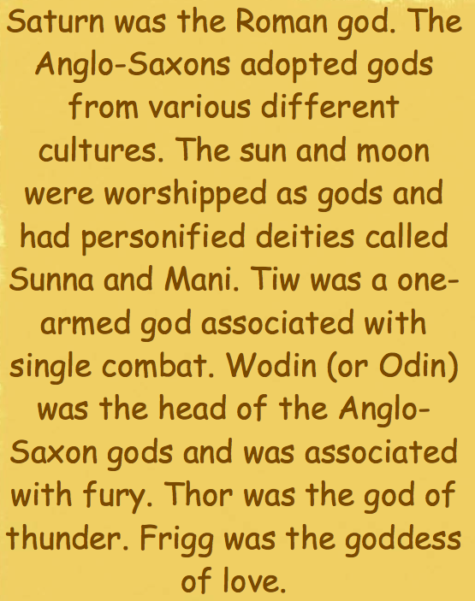
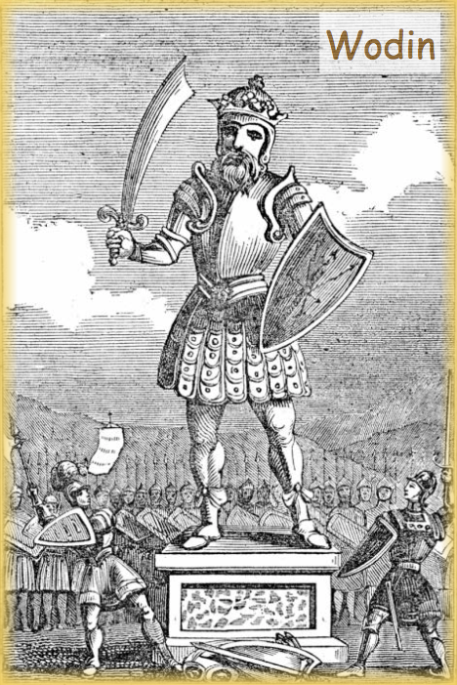
Saturn!

Slide 6
Woden – King of the Gods
The Anglo-Saxons held the gods in such high esteem that four days of the week were named after them. These also link to how the Romans named the seven-day week.
Day | The Roman name | Roman meaning | The god after whom the Anglo Saxons named their days
Monday | dies Lunae | The Day of the Moon
Tuesday | dies Martis | The Day of Mars | Tiw
Wednesday | dies Mercurii | The Day of Mercury | Woden
Thursday | dies Iovis | The Day of Jupiter | Thuner
Friday | dies Veneris | The Day of Venus | Frige
Saturday | dies Saturni | The Day of Saturn
Sunday | dies Solis | The Day of The Sun
Find out more: Look up the French words for days of the week, what you notice?
Notes:
The links between the Anglo-Saxon and Roman days of the week: Tuesday – Mars was the Roman god of war as was Tiw for the Anglo-Saxons; Wednesday – Mercury and Woden were both chief gods as well as being gods of the dead and were often portrayed wearing a hat and carrying a staff; Thursday – Jupiter and Thuner were both gods of thunder and lightning; Friday – Venus and Frige were both associated with love and family.

Slide 7
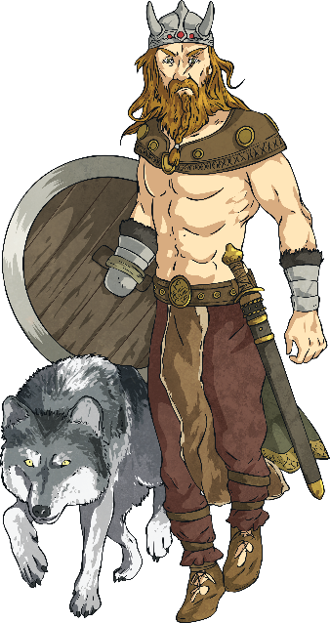
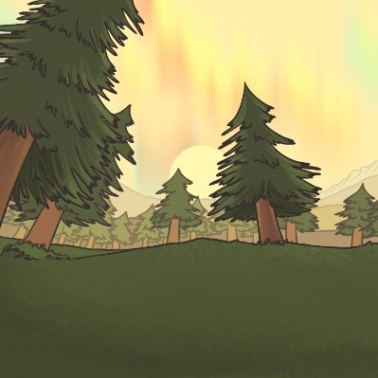
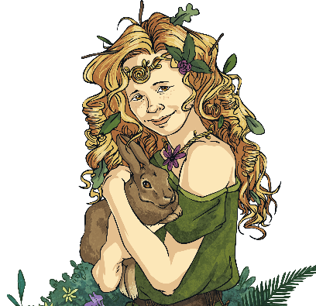
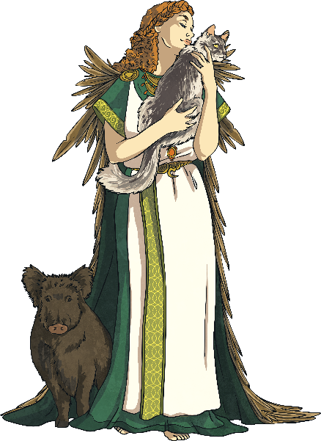
Meet the Gods
Click on a god or goddess to find out more about them.
More Gods
Notes:
The links between the Anglo-Saxon and Roman days of the week: Tuesday – Mars was the Roman god of war as was Tiw for the Anglo-Saxons; Wednesday – Mercury and Woden were both chief gods as well as being gods of the dead and were often portrayed wearing a hat and carrying a staff; Thursday – Jupiter and Thuner were both gods of thunder and lightning; Friday – Venus and Frige were both associated with love and family.

Slide 8
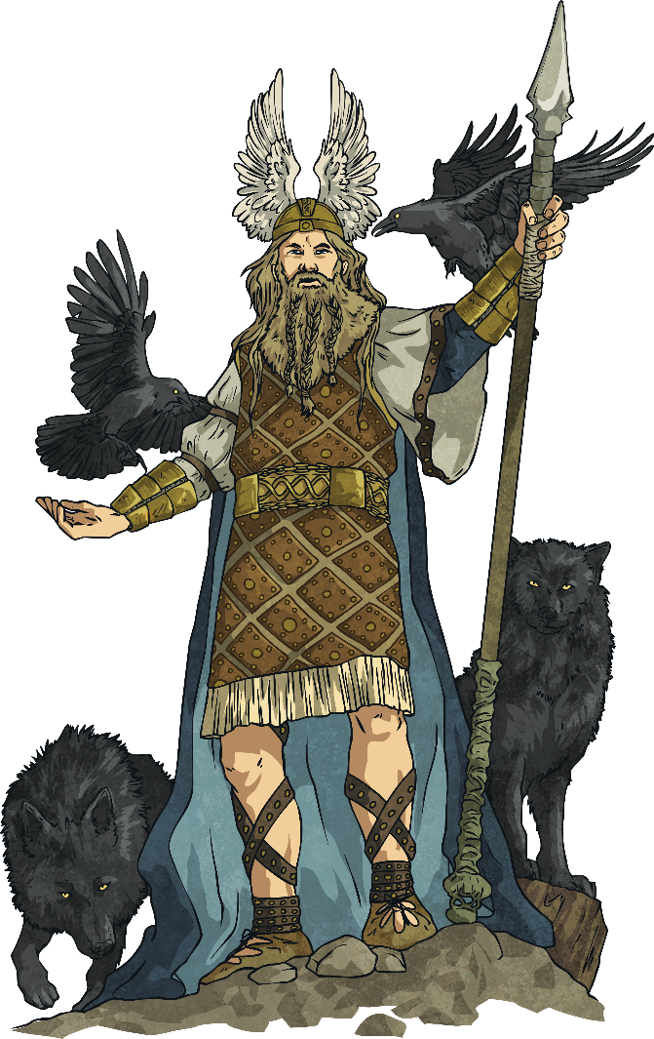
Woden – King of the Gods
Name: Woden
Nickname: Grim
Jobs: chief of the gods, god of war
Family: husband of Frige, father of Thunor and Bealdor
Sacred Animals: wolf, raven
Sacred Plant: ash tree
Equivalent Roman God: Mercury
Equivalent Norse God: Odin
Sacred Weapon: spear
Characteristics
Woden was sometimes shown with one eye, two
pet wolves and a horse with eight legs.
back
Notes:
The links between the Anglo-Saxon and Roman days of the week: Tuesday – Mars was the Roman god of war as was Tiw for the Anglo-Saxons; Wednesday – Mercury and Woden were both chief gods as well as being gods of the dead and were often portrayed wearing a hat and carrying a staff; Thursday – Jupiter and Thuner were both gods of thunder and lightning; Friday – Venus and Frige were both associated with love and family.

Slide 9
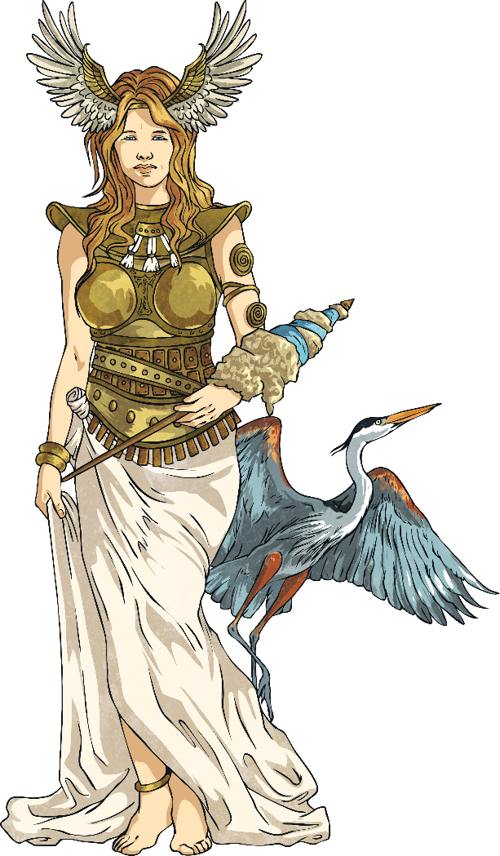
Frige – Goddess of the Home
Name: Frige
Jobs: goddess of the home, marriage, childbirth, Earth and harvest
Family: married to Woden, mother of Thunor and Bealdor
Sacred Animal: stork
Sacred Star Constellation: Orion’s Belt
Sacred Tool: spinning wheel
Equivalent Norse God: Frigg (married to Odin)
Equivalent Roman God: Venus
back
Notes:
The links between the Anglo-Saxon and Roman days of the week: Tuesday – Mars was the Roman god of war as was Tiw for the Anglo-Saxons; Wednesday – Mercury and Woden were both chief gods as well as being gods of the dead and were often portrayed wearing a hat and carrying a staff; Thursday – Jupiter and Thuner were both gods of thunder and lightning; Friday – Venus and Frige were both associated with love and family.

Slide 10
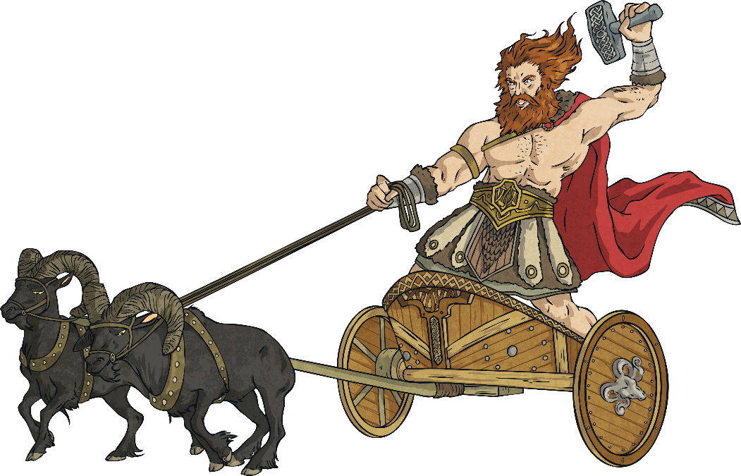
Thunor – God of Thunder
Name: Thunor
Job: god of storms, thunder and lightning
Family: son of Woden
Sacred Animal: goat
Sacred Plant: oak tree
Sacred Weapon: hammer
Equivalent Norse God: Thor
Equivalent Roman God: Jupiter
Characteristics
Thunor was often depicted on a chariot pulled by goats.
back
Notes:
The links between the Anglo-Saxon and Roman days of the week: Tuesday – Mars was the Roman god of war as was Tiw for the Anglo-Saxons; Wednesday – Mercury and Woden were both chief gods as well as being gods of the dead and were often portrayed wearing a hat and carrying a staff; Thursday – Jupiter and Thuner were both gods of thunder and lightning; Friday – Venus and Frige were both associated with love and family.

Slide 11
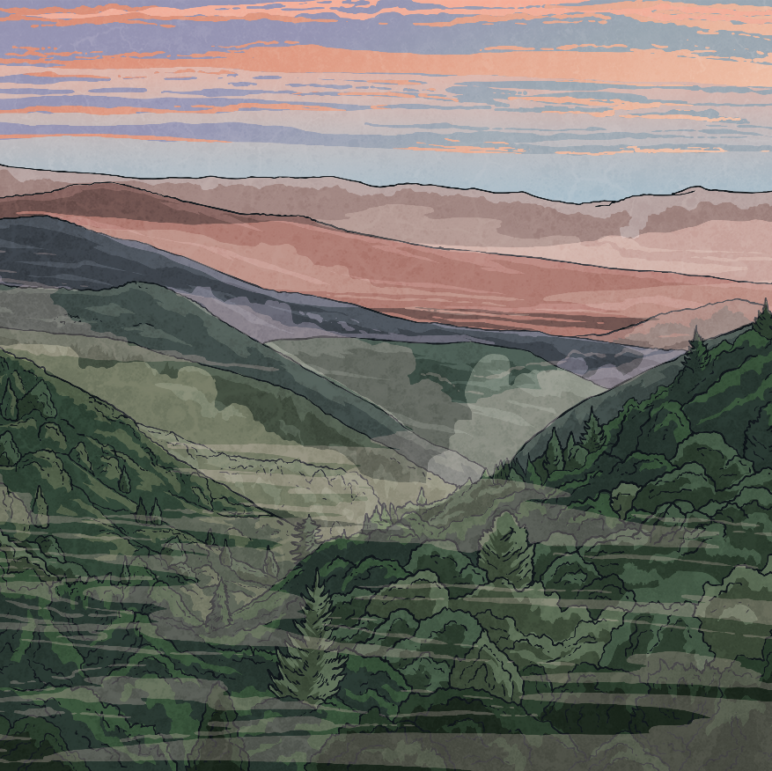
Freo – Goddess of Love
Name: Freo
Job: goddess of love
Family: sister of Ingui
Sacred Animals: cat, boar
Equivalent Norse God: Freya
Equivalent Roman God: Venus
Characteristics
Freo wore a magic cloak of falcon feathers and a necklace called ‘Brisingamen’.
back
Notes:
The links between the Anglo-Saxon and Roman days of the week: Tuesday – Mars was the Roman god of war as was Tiw for the Anglo-Saxons; Wednesday – Mercury and Woden were both chief gods as well as being gods of the dead and were often portrayed wearing a hat and carrying a staff; Thursday – Jupiter and Thuner were both gods of thunder and lightning; Friday – Venus and Frige were both associated with love and family.

Slide 12
Eostre – Goddess of Spring
Name: Eostre
Job: goddess of spring, goddess of rebirth
Sacred Animal: hare
Sacred Symbol: egg Equivalent Norse God: Austra
Equivalent Roman God: Aurora Special Month: April
(around where Easter is now)
Although Shrove Tuesday is sometimes in February and
sometimes in March, it is very close to the time when
Anglo Saxons offered cakes to their Gods.
back
Notes:
The links between the Anglo-Saxon and Roman days of the week: Tuesday – Mars was the Roman god of war as was Tiw for the Anglo-Saxons; Wednesday – Mercury and Woden were both chief gods as well as being gods of the dead and were often portrayed wearing a hat and carrying a staff; Thursday – Jupiter and Thuner were both gods of thunder and lightning; Friday – Venus and Frige were both associated with love and family.

Slide 13
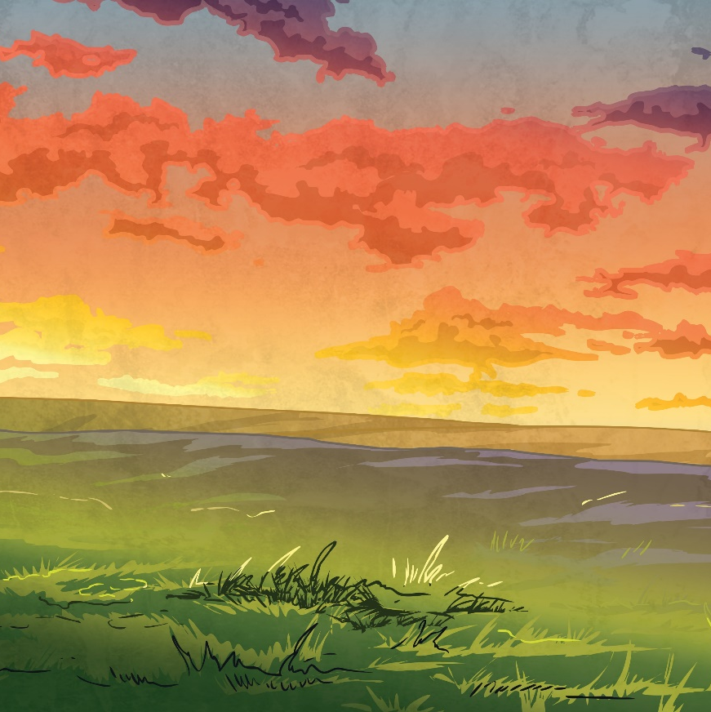
Tiw – God of War
Name: Tiw
Job: god of war, justice and a sky god
Sacred Animal: wolf
Equivalent Norse God: Tyr
Equivalent Roman God: Mars
Characteristics
Tiw was often shown as having only one hand.
back
Notes:
The links between the Anglo-Saxon and Roman days of the week: Tuesday – Mars was the Roman god of war as was Tiw for the Anglo-Saxons; Wednesday – Mercury and Woden were both chief gods as well as being gods of the dead and were often portrayed wearing a hat and carrying a staff; Thursday – Jupiter and Thuner were both gods of thunder and lightning; Friday – Venus and Frige were both associated with love and family.

Slide 14
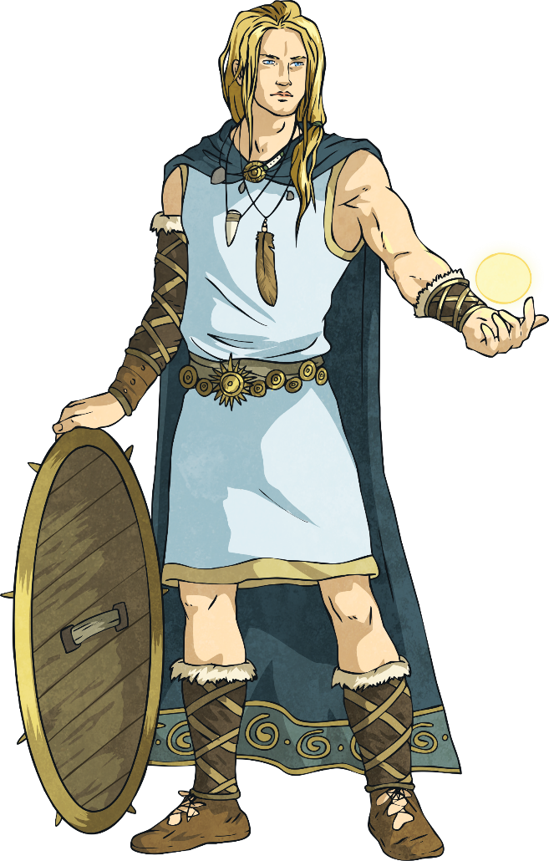
Bealdor – God of Light
Name: Bealdor
Job: god of light
Family: son of Woden and Frige
Equivalent Norse God: Baldr
Equivalent Roman God: Apollo
Characteristics
He gave off light from his good looks, generosity and goodness.
back
Notes:
The links between the Anglo-Saxon and Roman days of the week: Tuesday – Mars was the Roman god of war as was Tiw for the Anglo-Saxons; Wednesday – Mercury and Woden were both chief gods as well as being gods of the dead and were often portrayed wearing a hat and carrying a staff; Thursday – Jupiter and Thuner were both gods of thunder and lightning; Friday – Venus and Frige were both associated with love and family.

Slide 15
Other Gods and Goddesses
Name: Loki
Job: god of deceit and cunning
Family: father of Hell (goddess of death, ruler of the afterlife)
Characteristics: Christians thought he was the devil.
Name: Wade
Job: god of the sea, guardian of fords and ferries
Family: father of Wayland
Characteristics: He was a giant and had his own ship.
Name: Ingui
Job: King of elves
Family: brother of Freo
Sacred Animal: boar
Characteristics: Ingui has a beard and carries a magic sword.
Name: Seaxneat
Job: god of family
Family: brother of Freo
Characteristics: He was a special god for the Saxons, not Jutes or Angles.
Name: Hretha
Job: goddess of fame, goddess of war
Special Month: March
Places: The names of places beginning with Rad, Red or Read are probably after her.
Next Page

Slide 16
The Arrival of Christianity
The Romans did introduce Christianity to Britain but the Anglo-Saxons mainly kept their pagan beliefs.
Later, in AD 597 the pope in Rome sent a missionary (someone who promotes a religion in another country) to travel to Britain to spread the word of Christianity and help convert people to the religion.
This missionary was a monk named Augustine. He was successful in converting Ethelbert, the King of Kent, to Christianity and King Ethelbert even built
Augustine a Church at Canterbury.
Augustine became the first Archbishop of Canterbury and the one named as the founder of the Church of England.
Next Page

Slide 17
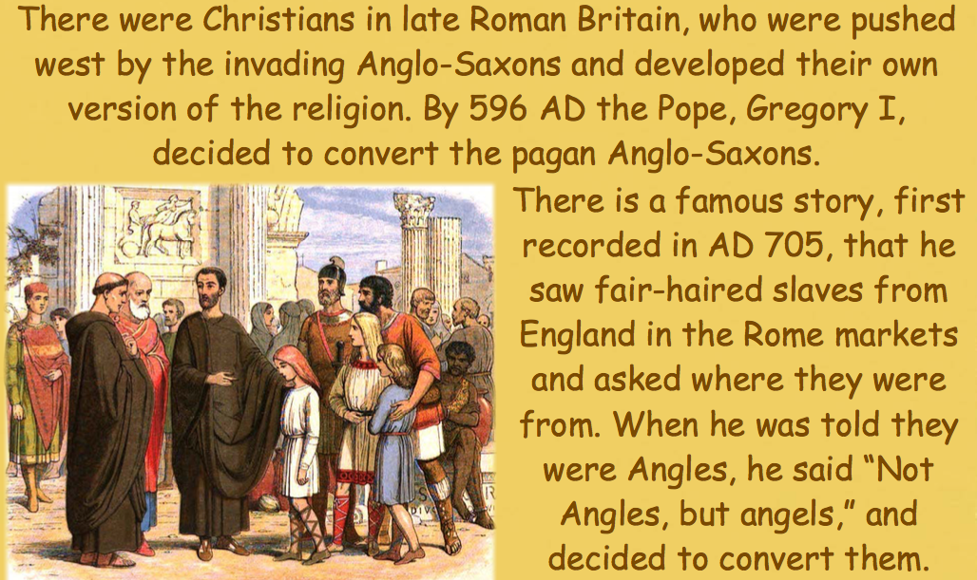
Pagan or Christian

Slide 18
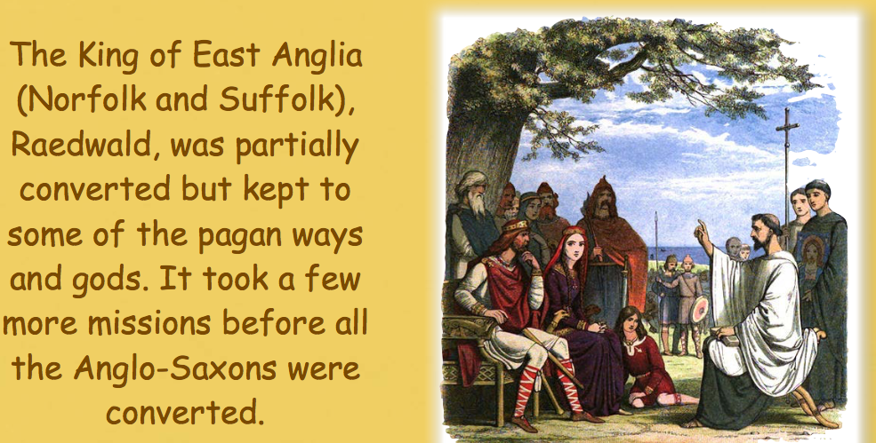
The Pope sent Augustine to England to convert as many people as possible, especially the King of Kent. Conversion was made official with baptism in a river or stream.
Where have you heard of King Raedwald before?

Slide 19
The Arrival of Christianity

Slide 20
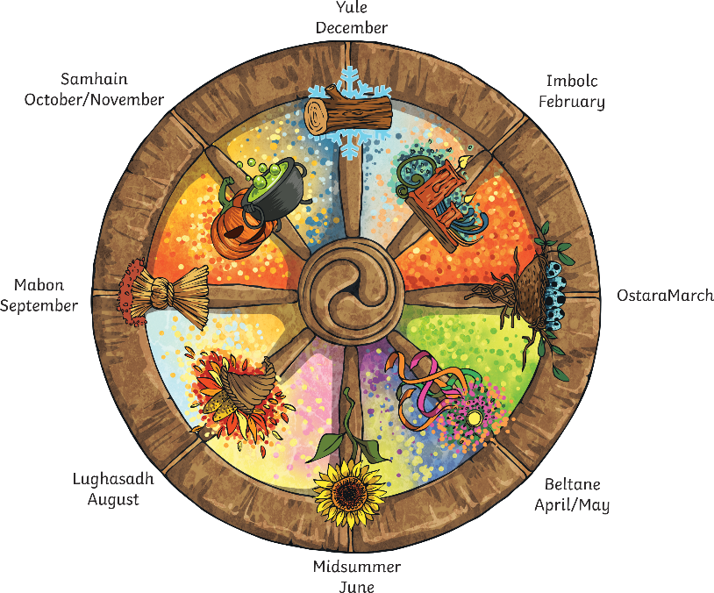
The Arrival of Christianity
The Anglo-Saxons, just like most communities and religions, celebrated festivals during the year.
Their months were based on the moon (where the word ‘month’ comes from), making the year 354 days long and this resulted in an extra month every few years.
Anglo-Saxon festivals align with similar Christian festivals and all fit with the changing seasons. Significant points in the year were the summer and winter solstices (near when we find Christmas) and Eostre in the springtime when things started to grow again – when Easter is now.
Find out more:
Look at this pagan ‘wheel of the year’ and see how it lines up with Christian festivals and the seasons.

Slide 21
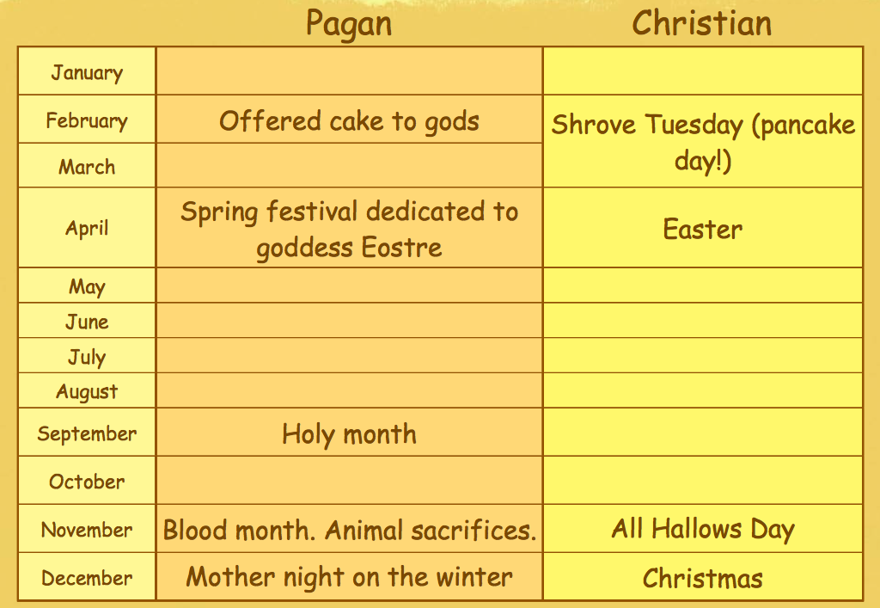
Pagan or Christian

Slide 22
Pagan or Christian

Slide 23
Pagan or Christian

Slide 24
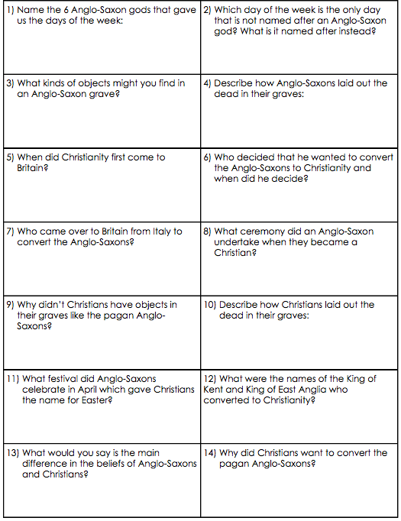
Independent Activities
See if you can answer the questions on the work sheet (which you can download from the School Website, or answer on a piece of paper at home).
Remember you can always go back through the PowerPoint if you need to!
Good luck!

Slide 25
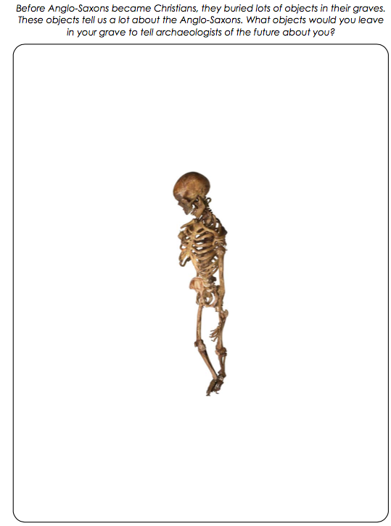
Extension
Activity
Use your knowledge and understanding of different soils and materials to think about what objects you might bury with you to tell future archaeologists about your life.

