Slide 1
Maths Week Two
Calculating the area of a shape by counting squares
Lesson Three

Slide 2
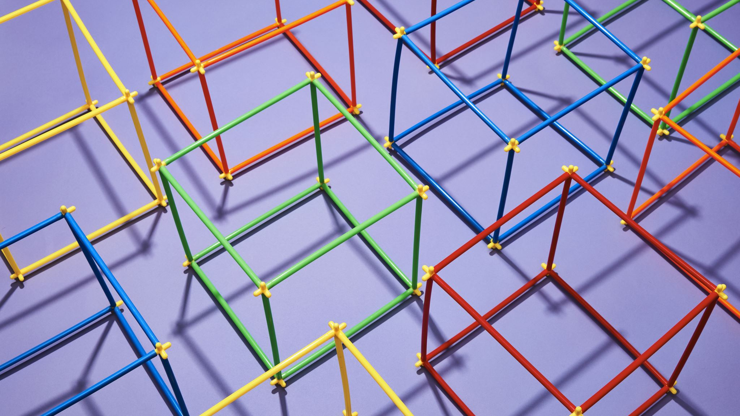
Today we are going to carry on exploring the area of shapes
The shapes might not be rectangles today

Slide 3
Lesson Three Today we are going to carry on looking at harder irregular shapes and finish by starting to problem-solve using area

Slide 4
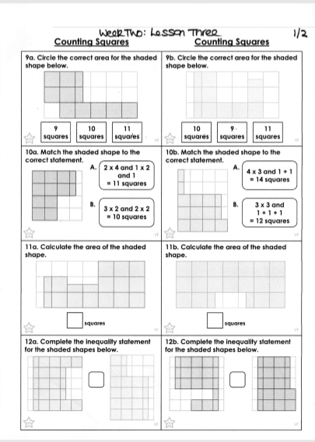
You will need this sheet first

Slide 5
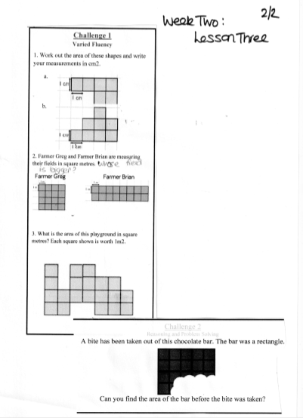
You will need this sheet next

Slide 6
That’s all there is to it!

