Slide 2
Diving into Mastery Guidance for Educators
Each activity sheet is split into three sections, diving, deeper and deepest, which are represented by the following icons:
These carefully designed activities take your children through a learning journey, initially ensuring they are fluent with the key concept being taught; then applying this to a range of reasoning and problem-solving activities.
These sheets might not necessarily be used in a linear way. Some children might begin at the ‘Deeper’ section and in fact, others may ‘dive straight in’ to the ‘Deepest’ section if they have already mastered the skill and are applying this to show their depth of understanding.
Diving
Deeper
Deepest

Slide 3
Aim
Know angles are measured in degrees; estimate and compare acute, obtuse and reflex angles.

Slide 4
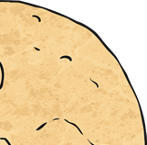
Measuring Angles in Degrees
Diving
What type of angle is shown in each biscuit picture?
Estimate the size of each angle.
Remember to use what you already know about angle properties.
reflex
230°
acute
45°
obtuse
120 °

Slide 5
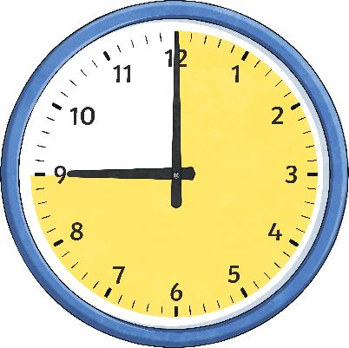
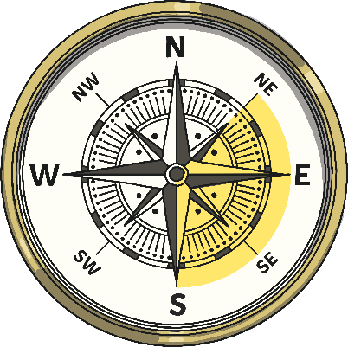
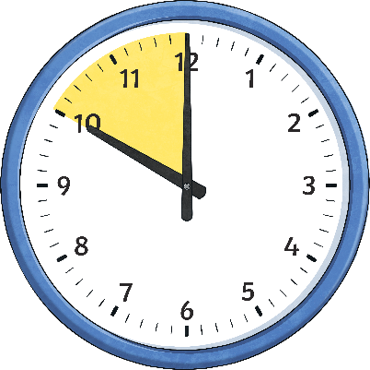
Measuring Angles in Degrees
Diving
Estimate the angles and then order from smallest to greatest.
acute
60°
obtuse
135°
reflex
270°
reflex
310°

Slide 6
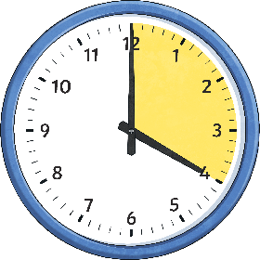
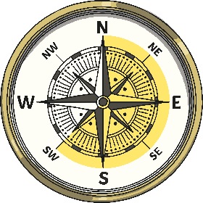
Measuring Angles in Degrees
Deeper
Use the greater than, less than and equals symbols to complete these statements.
<
a quarter turn
=
⅝ of a turn
>
<
¾ of a turn
a right angle

Slide 7
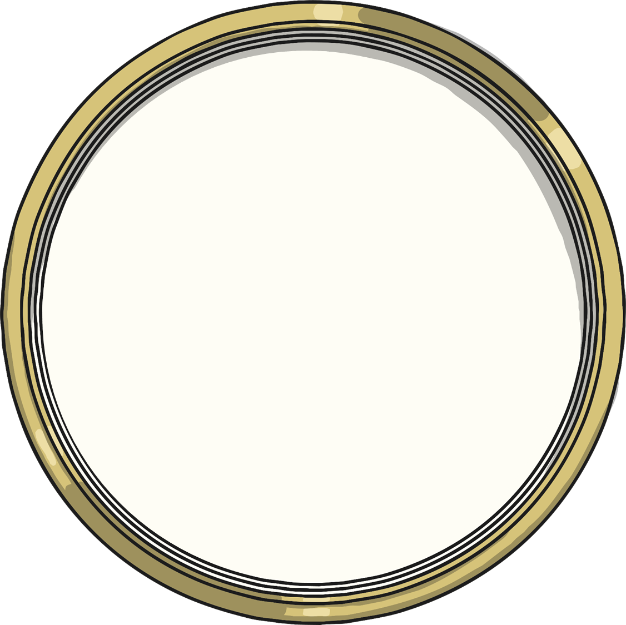
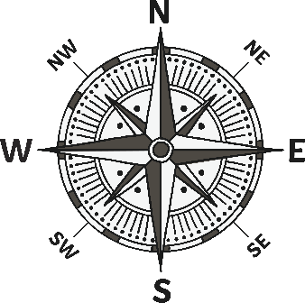
Measuring Angles in Degrees
Deeper
If I turn in a clockwise direction from north to north-west, my turn is an acute angle.
Is Sam correct? Explain your answer.
Sam is incorrect. If you turn clockwise from north to north-west, this is nearly a full turn. It is 315°.
If Sam had turned anticlockwise, this would have been an acute angle of 45°.

Slide 8
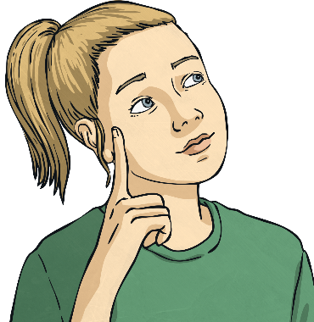
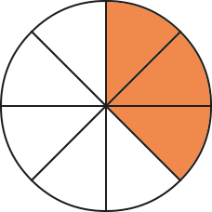
Measuring Angles in Degrees
Deepest
True or False?
⅜ of a whole turn is less than a right angle.
False. ⅜ of a whole turn is 135° and a right angle is 90°.

Slide 9
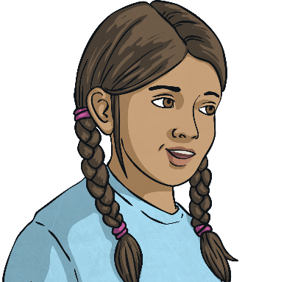
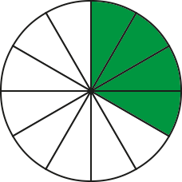
Measuring Angles in Degrees
Deepest
True or False?
⅓ of a whole turn is less than of a turn.
₅
₁₂
True. ⅓ of a whole turn is 120° and of a turn is 150°. An alternative way of answering this is to use our equivalent fractions knowledge to convert ⅓ to . is less than .
₅
₁₂
₄
₄
₅
₁₂
₁₂
₁₂

Slide 10
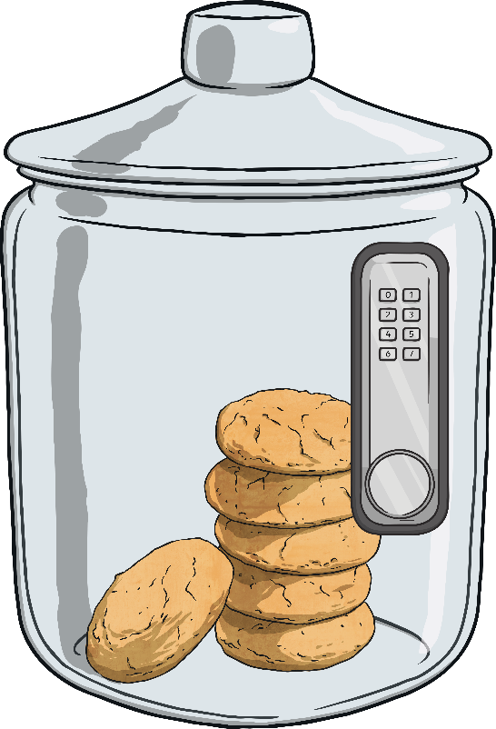
Measuring Angles in Degrees
Deepest
Can you follow the instructions to work out the code to unlock the biscuit jar?
Imagine you are facing 1. Make a ¼ turn clockwise.
Now turn 180° anticlockwise.
Now turn a right angle anticlockwise.
Finally, turn a ¾ turn clockwise.
3
7
5
0
7
1
3
6
2
5
3
4

Slide 11
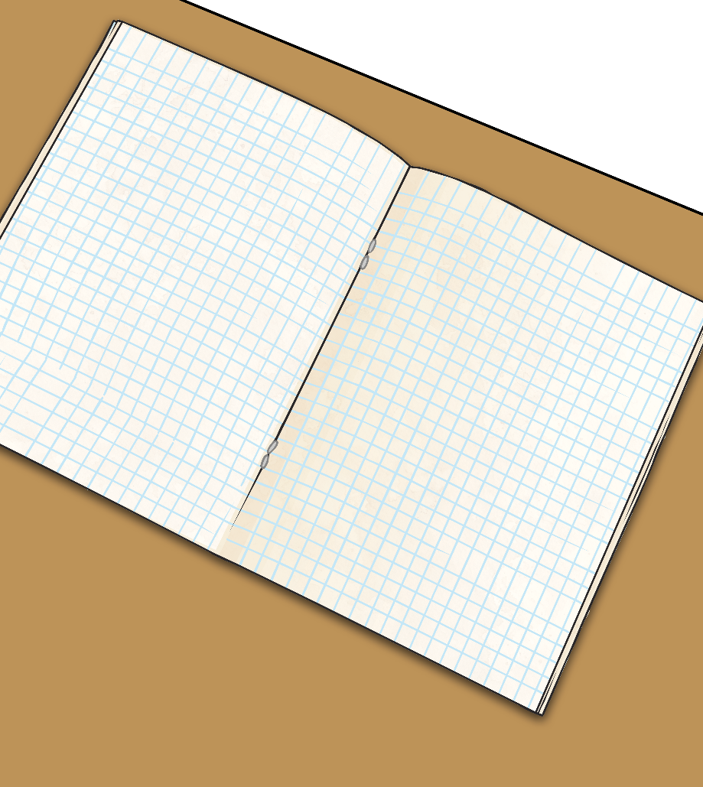
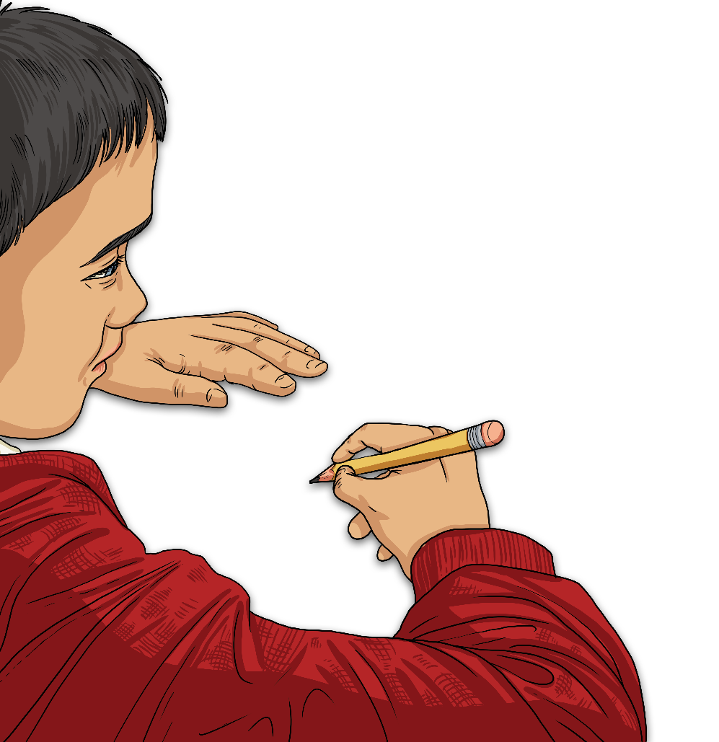
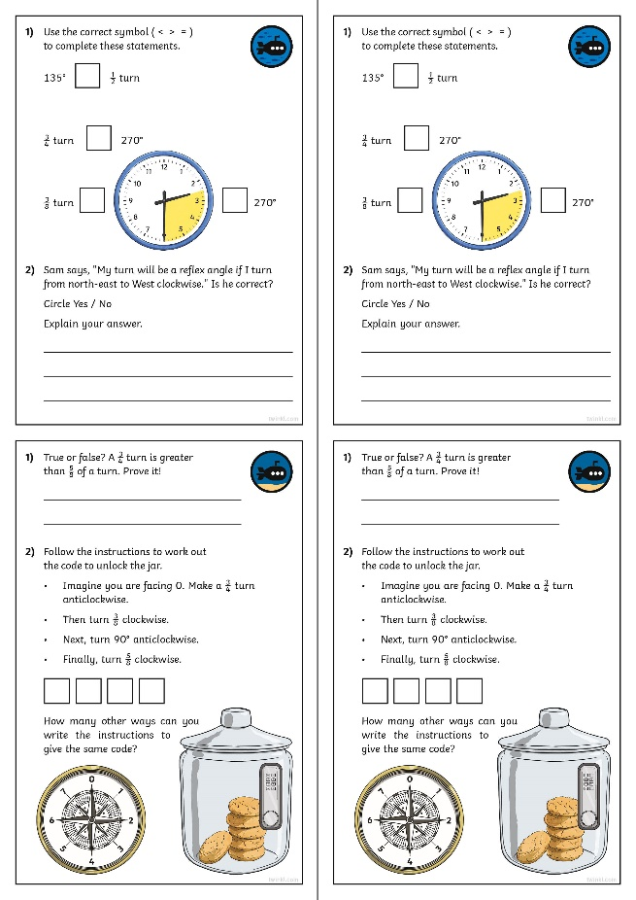
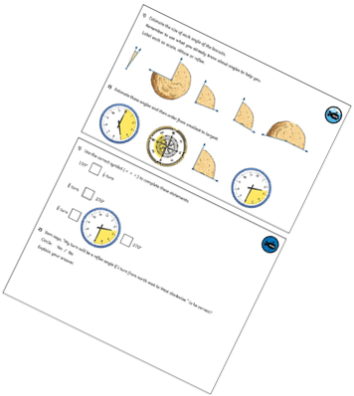
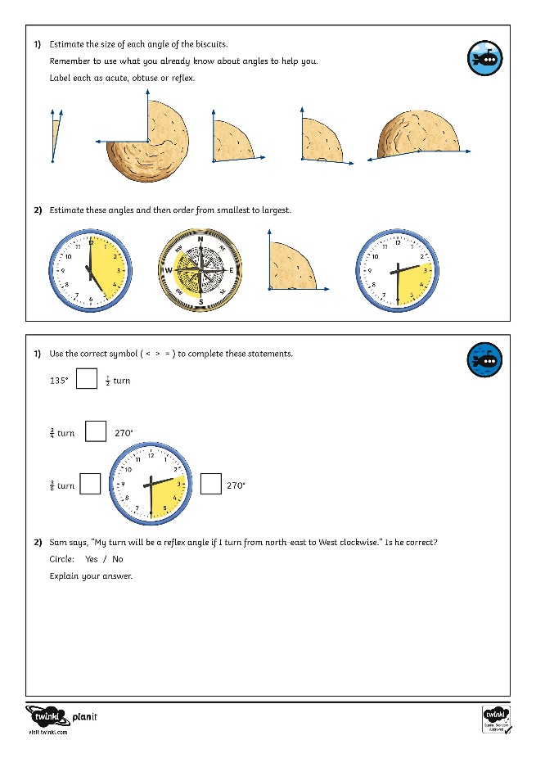
Independent Work
Download these sheets from the Class 5 webpage. Good luck!
Calculating Angles on a Straight Line
Dive in by completing your own activity!

