Slide 1
Maths
Measurement
Year One
Maths | Year 4 | Measurement | Telling the Time 12-Hour and 24-Hour | Lesson 2 of 4: Digital to Analogue

Slide 3
Aim
I can convert between digital and analogue clock times.
Success Criteria
I can write digital past-the-hour times in numbers and words.
I can write past-the-hour times shown on an analogue clock in digital form.
I can write digital to-the-hour times in numbers and words.
I can write to-the-hour times shown on an analogue clock in digital form.

Slide 4
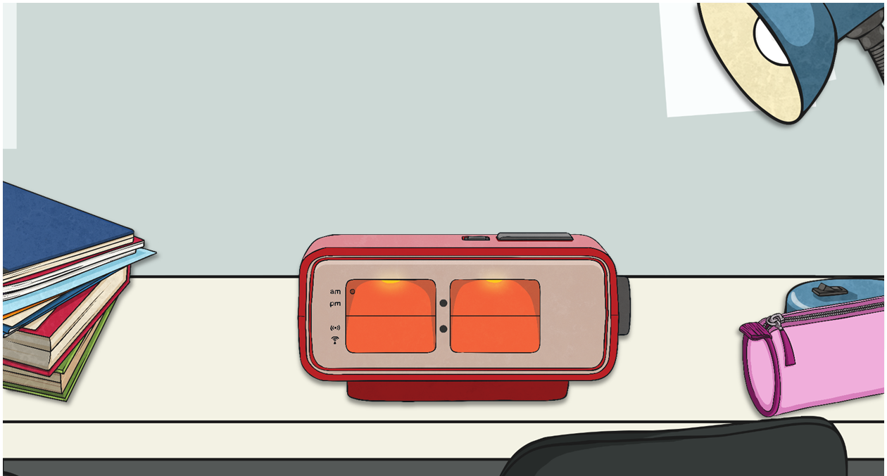
Learning How to Read Digital Times
Minute Intervals past the Hour
The numbers after the colon show the minutes.
The numbers before the colon show the hours since midnight or midday.
On this clock, the hour is 5.
13 minutes have passed since the hour.
The time is 13 minutes past 5.

Slide 5
Learning How to Read Digital Times
Minute Intervals Past the Hour
?
What is the time?
The hour is 10.
22 minutes have passed since the hour.
The time is 22 minutes past 10.

Slide 6
Learning How to Read Digital Times
Minute Intervals Past the Hour
?
What is the time?
The hour is 3.
17 minutes have passed since the hour.
The time is 17 minutes past 3.

Slide 7
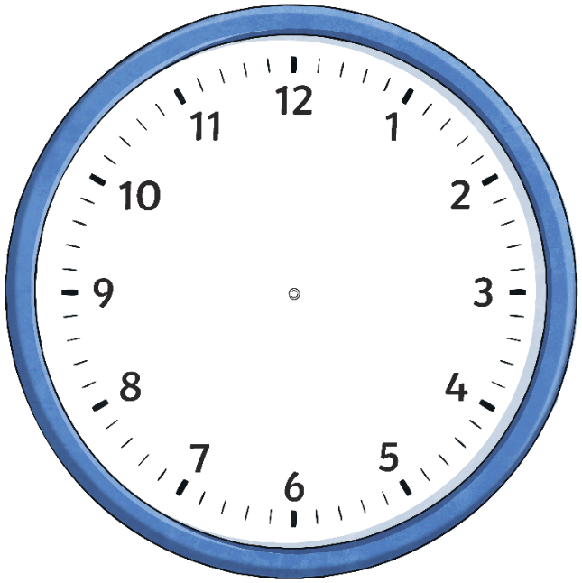
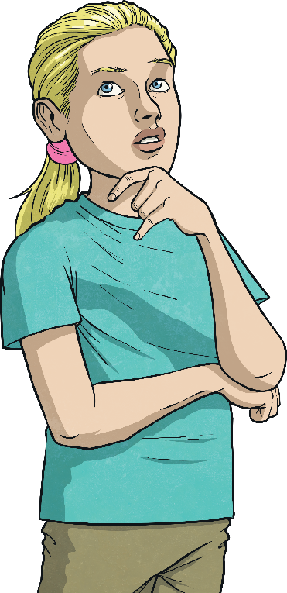
What’s the Time?
Set these digital times on an analogue clock.
Then, write the time in numbers and words.
8:17
What time is it?
11:28
17 minutes past 8
28 minutes past 11

Slide 8
What’s the Time?
Set these digital times on an analogue clock.
Then, write the time in numbers and words.
2:13
What time is it?
4:06
13 minutes past 2
6 minutes past 4

Slide 9
What’s the Time?
Set these digital times on an analogue clock.
Then, write the time in numbers and words.
9:22
What time is it?
12:14
22 minutes past 9
14 minutes past 12

Slide 10
What’s the Time?
Write the time in digital form for these analogue times.
What time is it?
6:12
2:24
12 minutes past 6
24 minutes past 2

Slide 11
What’s the Time?
Write the time in digital form for these analogue times.
What time is it?
10:03
1:27
3 minutes past 10
27 minutes past 1

Slide 12
What’s the Time?
Write the time in digital form for these analogue times.
What time is it?
8:11
11:09
11 minutes past 8
9 minutes past 11

Slide 13
Learning How to Read Digital Times
Minute Intervals to the Hour
On this clock, the hour is 7.
52 minutes have passed since the hour.
The numbers before the colon show the hours.
The numbers after the colon show the minutes.
Once the time is more than 30 minutes past the hour, we say how many minutes are left to the next hour.
Remember, there are 60 minutes in an hour.
+ 8
52
60
The time is 8 minutes to 8.

Slide 14
Learning How to Read Digital Times
Minute Intervals to the Hour
The hour is 10.
47 minutes have passed since the hour.
+ 13
47
60
The time is 13 minutes to 11.

Slide 15
Learning How to Read Digital Times
Minute Intervals to the Hour
On this clock, the hour is 4.
36 minutes have passed since the hour.
?
What time is it in numbers and words?
Hint: how many minutes until the next hour?
The time is 24 minutes to 5.

Slide 16
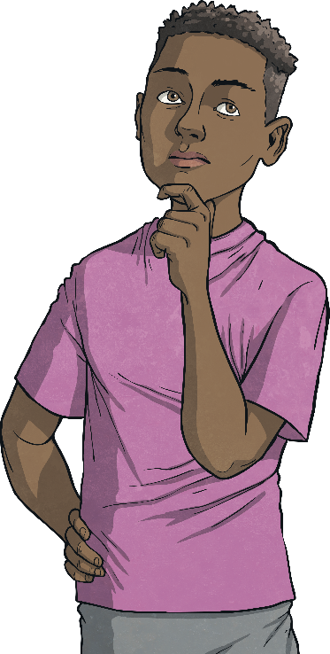
How Many Minutes to?
Set these digital times on an analogue clock.
9:37
What time is it?
3:58
23 minutes to 10
2 minutes to 4

Slide 17
How Many Minutes To?
Set these digital times on an analogue clock.
8:49
What time is it?
1:32
11 minutes to 9
28 minutes to 2

Slide 18
How Many Minutes To?
Set these digital times on an analogue clock.
1:51
What time is it?
6:43
9 minutes to 2
17 minutes to 7

Slide 19
How Many Minutes To?
What time is shown on each clock?
What would this be as a digital time?
What time is it?
3 minutes to 9
18 minutes to 3
8:57
2:42

Slide 20
How Many Minutes To?
What time is shown on each clock?
What would this be as a digital time?
What time is it?
16 minutes to 5
8 minutes to 10
4:44
9:52

Slide 21
How Many Minutes To?
What time is shown on each clock?
What would this be as a digital time?
What time is it?
29 minutes to 4
11 minutes to 11
3:31
10:49

Slide 22
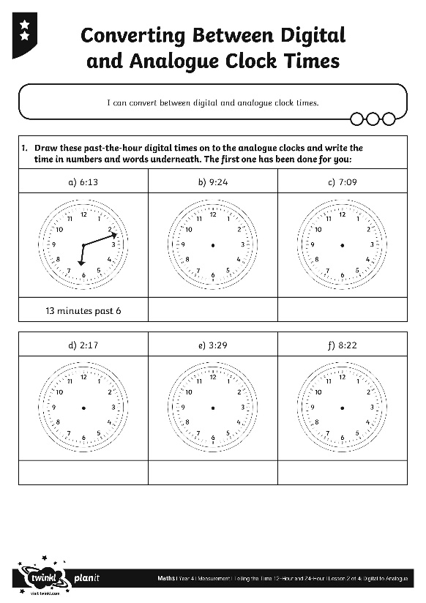
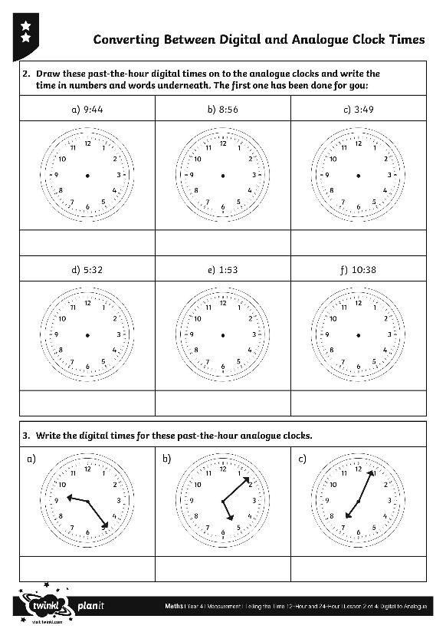
Converting between Digital
and Analogue Clock Times
Use your terrific time skills to complete the activity sheet.

Slide 23
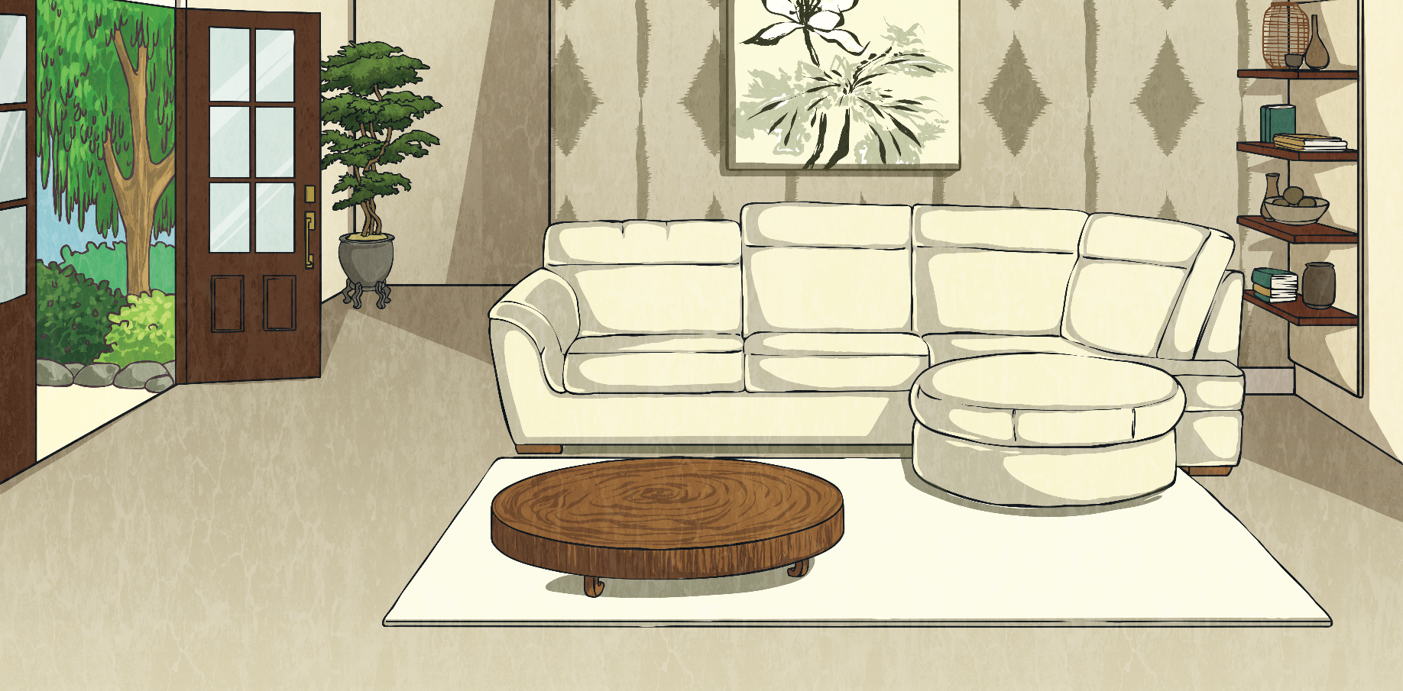
TV Times
Here is an evening TV schedule. Some of the times have been written in digital form and some of them have been written in words and numbers. Copy the table and fill in the missing times.
TV Programme | Digital | Analogue
Early Evening News | 6:04
You’re on Video! |  | 22 minutes past 6
Ann and Deb Show | 6:54
Toys’ Party (film) |  | 24 minutes to 8
Late News |  | 4 minutes to 10
4 minutes past 6
6:22
6 minutes to 7
7:36
9:56

Slide 24
Aim
I can convert between digital and analogue clock times.
Success Criteria
I can write digital past-the-hour times in numbers and words.
I can write past-the-hour times shown on an analogue clock in digital form.
I can write digital to-the-hour times in numbers and words.
I can write to-the-hour times shown on an analogue clock in digital form.

