Slide 1
ENGLISH Day 3
LO: To gather ideas for a chocolate-themed narrative poem

Slide 2
What does the word ‘unrequited’ mean?
A feeling (e.g. love) not returned.
What colour is the pig?
Why could Red be described as an Angry Bird?
https://www.youtube.com/watch?v=1U2DKKqxHgE
Why do you think the director chose two different pieces of music?

Slide 3
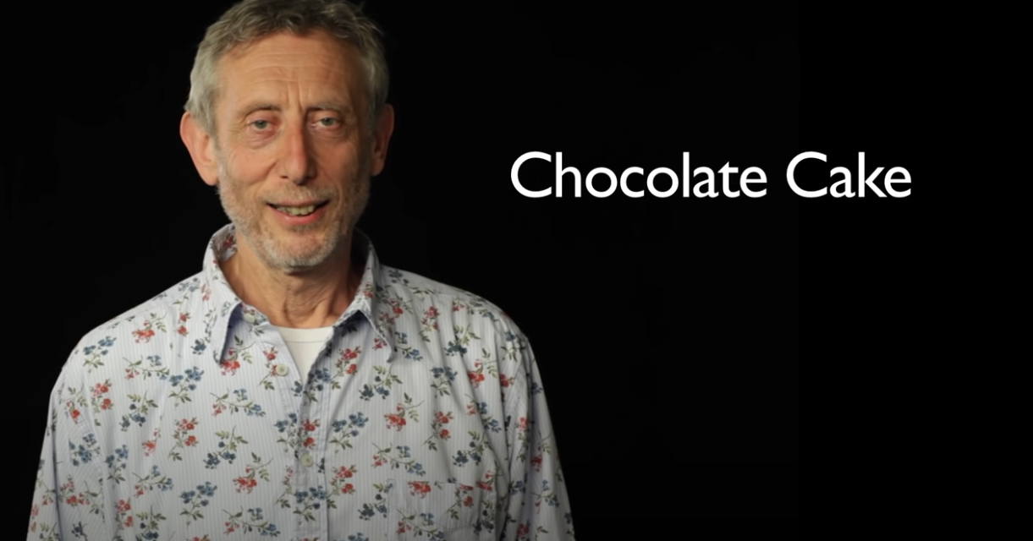
LO: To gather ideas for a chocolate-themed narrative poem ENGLISH Day 3
Last lesson we read the poem Chocolate Cake by Michael Rosen.
You can listen to it again, if you like.
https://www.youtube.com/watch?v=7BxQLITdOOc

Slide 4
LO: To gather ideas for a chocolate-themed narrative poem ENGLISH Day 3

Slide 5
LO: To gather ideas for a chocolate-themed narrative poem ENGLISH Day 3
What were some of the features of figurative writing we looked at last lesson?

Slide 6
LO: To gather ideas for a chocolate-themed narrative poem ENGLISH Day 3

Slide 7
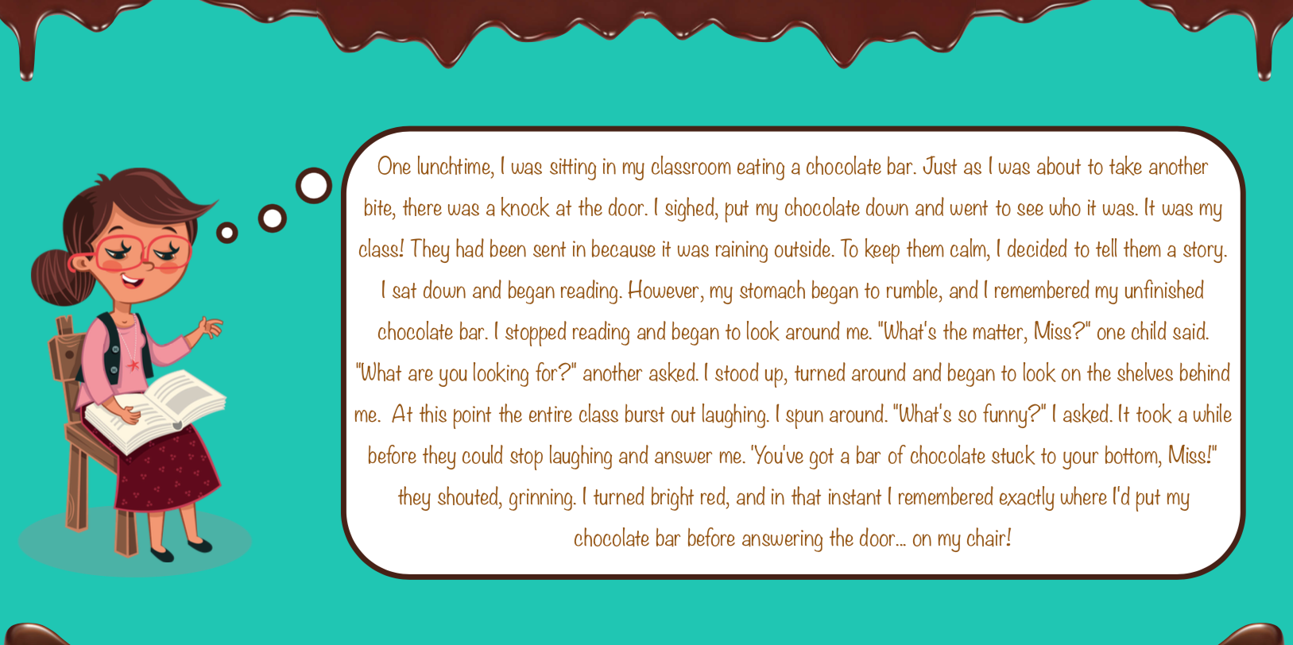
LO: To gather ideas for a chocolate-themed narrative poem ENGLISH Day 3

Slide 8
LO: To gather ideas for a chocolate-themed narrative poem ENGLISH Day 3
Can you identify each of the following in the teacher’s story about the chocolate incident?
Make notes in your exercise book under the different headings.

Slide 9
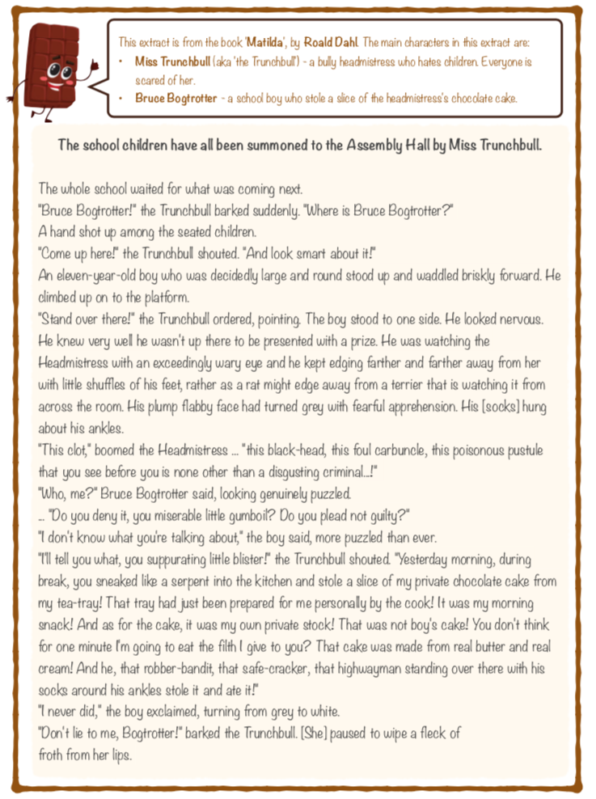
ENGLISH Day 3
LO: To gather ideas for a chocolate-themed narrative poem
Perhaps you know this story?
Can you think of any other chocolate-related stories by Roald Dahl?

Slide 10
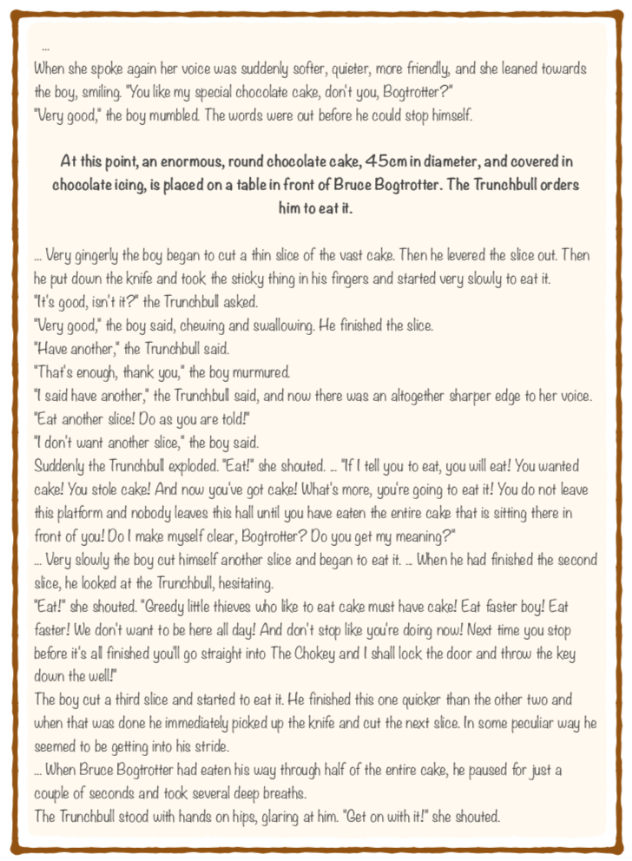
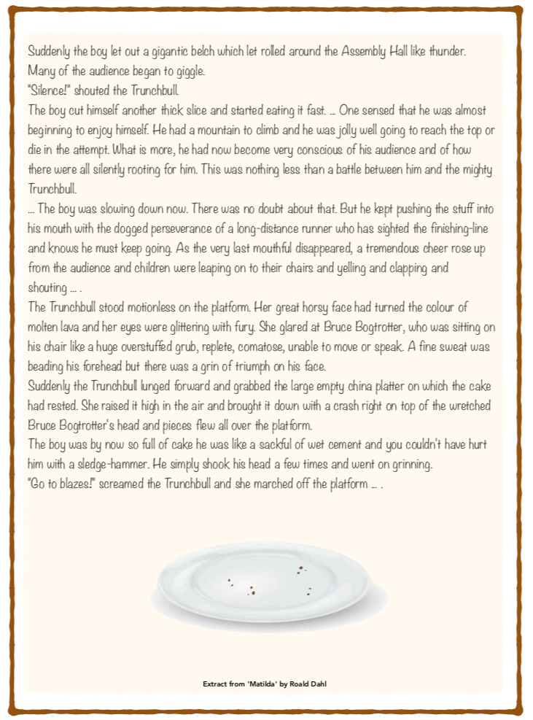

Slide 11
LO: To gather ideas for a chocolate-themed narrative poem ENGLISH Day 3

Slide 12
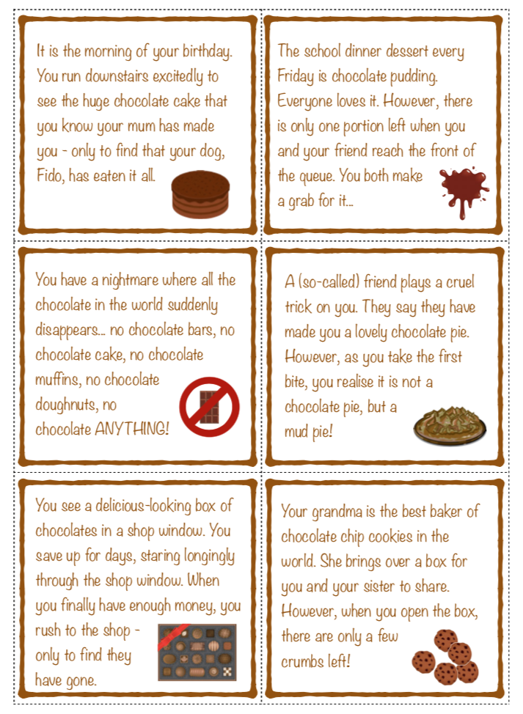
LO: To gather ideas for a chocolate-themed narrative poem ENGLISH Day 3
If you would like some ideas to get your started or if you are struggling to think of something, have a look at the different scenarios here.

Slide 13
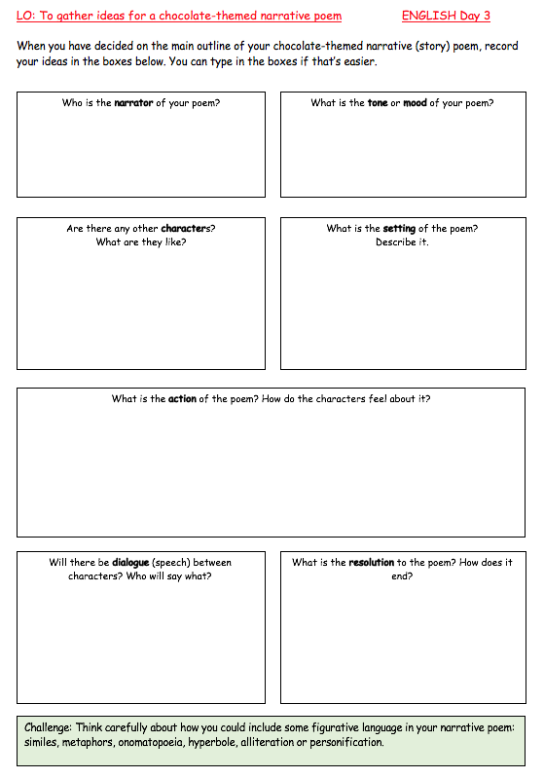
LO: To gather ideas for a chocolate-themed narrative poem
ENGLISH Day 3
Your Task
Plan your ideas using the work sheet.
You can download it from the Purple Mash English folder/the class web page or… write your ideas in your exercise book using the headings if that’s easier.
Please upload your finished work to Teams.
Under the Assignment page, click ADD WORK then the HAND IN button at the top.
*Hint* You will find the sheet on the Year 5 web page and Teams.
You should be able to type directly on to it.

Slide 14
LO: To know how to perform a poem
ENGLISH Day 2
Check list
Do I remember the similarities between a narrative poem and a story?
Can I generate ideas for my own chocolate-themed narrative poem?
Can I explain my ideas to someone at home, and respond to suggestions given?

Slide 15
LO: To know how to perform a poem ENGLISH Day 2
Chocolate Cake by Michael Rosen
I love chocolate cake. And when I was a boy I loved it even more. Sometimes we used to have it for tea and Mum used to say, 'If there's any left over you can have it to take to school tomorrow to have at playtime.' And the next day I would take it to school wrapped up in tin foil open it up at playtime and sit in the corner of the playground eating it, you know how the icing on top is all shiny and it cracks as you bite into it, and there's that other kind of icing in the middle and it sticks to your hands and you can lick your fingers and lick your lips oh it's lovely. yeah.
Anyway, once we had this chocolate cake for tea and later I went to bed but while I was in bed I found myself waking up licking my lips and smiling. I woke up proper. 'The chocolate cake.' It was the first thing I thought of. I could almost see it so I thought, what if I go downstairs and have a little nibble, yeah? It was all dark everyone was in bed so it must have been really late but I got out of bed, crept out of the door there's always a creaky floorboard, isn't there?

Slide 16
LO: To know how to perform a poem ENGLISH Day 2
Past Mum and Dad's room, careful not to tread on bits of broken toys or bits of Lego you know what it's like treading on Lego with your bare feet, yowwww shhhhhhh downstairs into the kitchen open the cupboard and there it is all shining. So I take it out of the cupboard put it on the table and I see that there's a few crumbs lying about on the plate, so I lick my finger and run my finger all over the crumbs scooping them up and put them into my mouth. oooooooommmmmmmmm
nice. Then I look again and on one side where it's been cut, it's all crumbly. So I take a knife I think I'll just tidy that up a bit, cut off the crumbly bits scoop them all up and into the mouth oooooommm mmmm nice. Look at the cake again. That looks a bit funny now, one side doesn't match the other I'll just even it up a bit, eh?

Slide 17
Chocolate Cake
by Michael Rosen
I love chocolate cake. And when I was a boy I loved it even more. Sometimes we used to have it for tea and Mum used to say, 'If there's any left over you can have it to take to school tomorrow to have at playtime.' And the next day I would take it to school wrapped up in tin foil open it up at playtime and sit in the corner of the playground eating it, you know how the icing on top is all shiny and it cracks as you bite into it, and there's that other kind of icing in the middle and it sticks to your hands and you can lick your fingers and lick your lips oh it's lovely. yeah.
LO: To know how to perform a poem ENGLISH Day 2
Take the knife and slice. This time the knife makes a little cracky noise as it goes through that hard icing on top. A whole slice this time, into the mouth. Oh the icing on top and the icing in the middle ohhhhhh oooo mmmmmm. But now I can't stop myself Knife - 1 just take any old slice at it and I've got this great big chunk and I'm cramming it in what a greedy pig but it's so nice,
and there's another and another and I'm squealing and I'm smacking my lips and I'm stuffing myself with it and before I know I've eaten the lot. The whole lot. I look at the plate. It's all gone. Oh no they're bound to notice, aren't they, a whole chocolate cake doesn't just disappear does it? What shall I do?

Slide 18
LO: To know how to perform a poem ENGLISH Day 2
I know. I'll wash the plate up, and the knife and put them away and maybe no one will notice, eh? So I do that and creep creep creep back to bed into bed doze off licking my lips with a lovely feeling in my belly. Mmmmrnmmmmm. In the morning I get up, downstairs, have breakfast, Mum's saying, 'Have you got your dinner money?' and I say, 'Yes.' 'And don't forget to take some chocolate cake with you.' I stopped breathing. 'What's the matter,' she says, 'you normally jump at chocolate cake?' I'm still not breathing, and she's looking at me very closely now. She's looking at me just below my mouth. 'What's that?' she says. 'What's what?' I say.
'What's that there?' 'Where?' 'There,' she says, pointing at my chin. 'I don't know,' I say. 'It looks like chocolate,' she says. 'It's not chocolate is it?' No answer. 'Is it?' 'I don't know.' She goes to the cupboard looks in, up, top, middle, bottom, turns back to me. 'It's gone. It's gone. You haven't eaten it, have you?' 'I don't know.' 'You don't know. You don't know if you've eaten a whole chocolate cake or not? When? When did you eat it?' So I told her, and she said well what could she say? 'That's the last time I give you any cake to take to school. Now go. Get out no wait not before you've washed your dirty sticky face.' I went upstairs looked in the mirror and there it was, just below my mouth, a chocolate smudge. The give-away. Maybe she'll forget about it by next week.

