Slide 1
Art Lesson 2
LO: To explore the features of Henri Rousseau’s paintings

Slide 2
LO: To explore the features of Henri Rousseau’s paintings

Slide 3
LO: To explore the features of Henri Rousseau’s paintings
If you can, write your ideas in your exercise book please.

Slide 4
LO: To explore the features of Henri Rousseau’s paintings

Slide 5
LO: To explore the features of Henri Rousseau’s paintings

Slide 6
LO: To explore the features of Henri Rousseau’s paintings
Write your ideas in your exercise book please.

Slide 7
LO: To explore the features of Henri Rousseau’s paintings

Slide 8
LO: To explore the features of Henri Rousseau’s paintings
Your TASK
On the next few slides, you will see lots of different pictures painted by Henri Rousseau.
Choose the painting you like the most.
Use the Blooms questions to answer questions about your chosen painting.
You may download the sheet (show on the next page) with the questions on and type on the document.
OR you could write them in your exercise book and take a photo.
ALL work needs to be uploaded back on to Teams please.

Slide 9
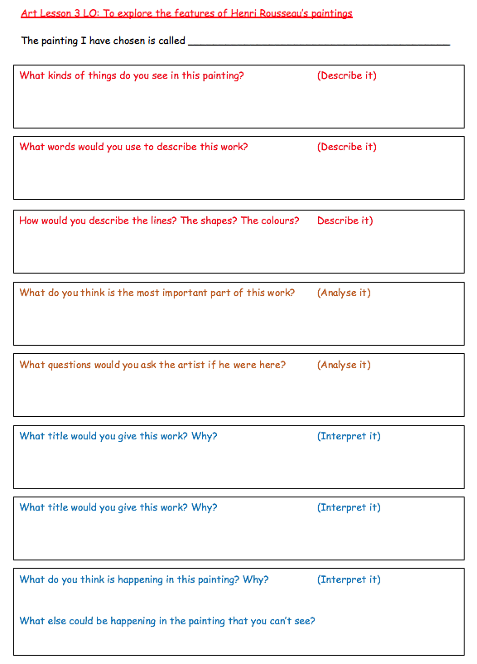
LO: To explore the features of Henri Rousseau’s paintings
Remember to write in FULL sentences please.
e.g. What colour is used the most in this work?
The colour that is used the most is….

Slide 10
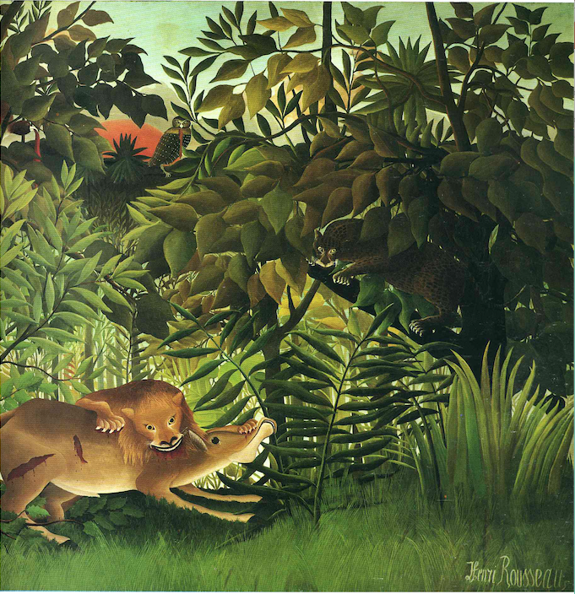

Slide 11
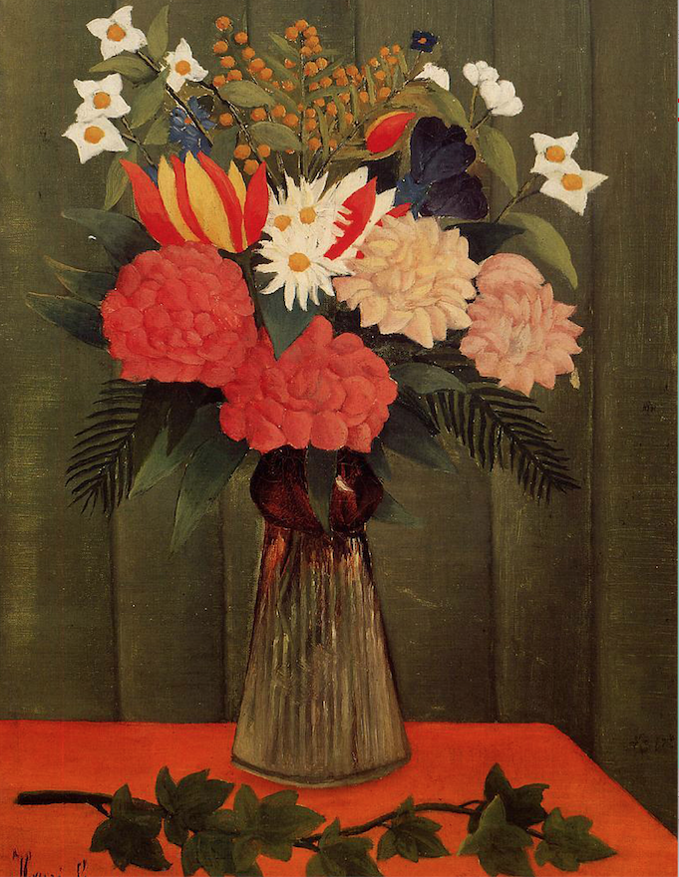

Slide 12
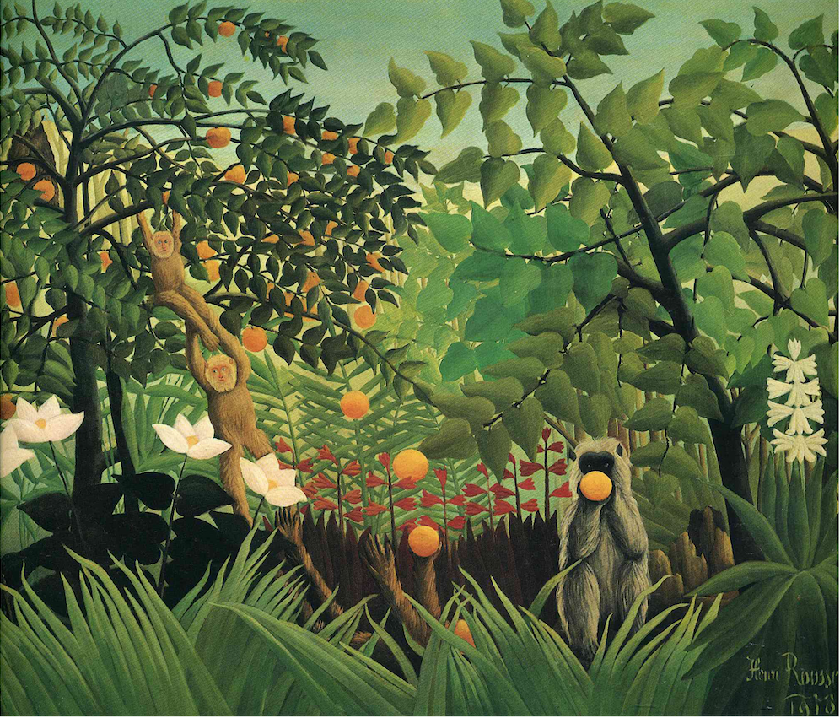

Slide 13
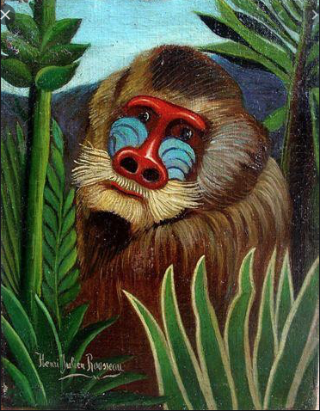
Mandrill in the Jungle, 1909

Slide 14
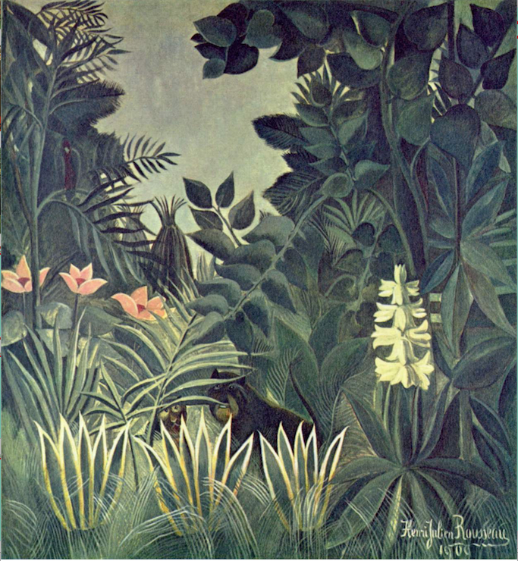

Slide 15
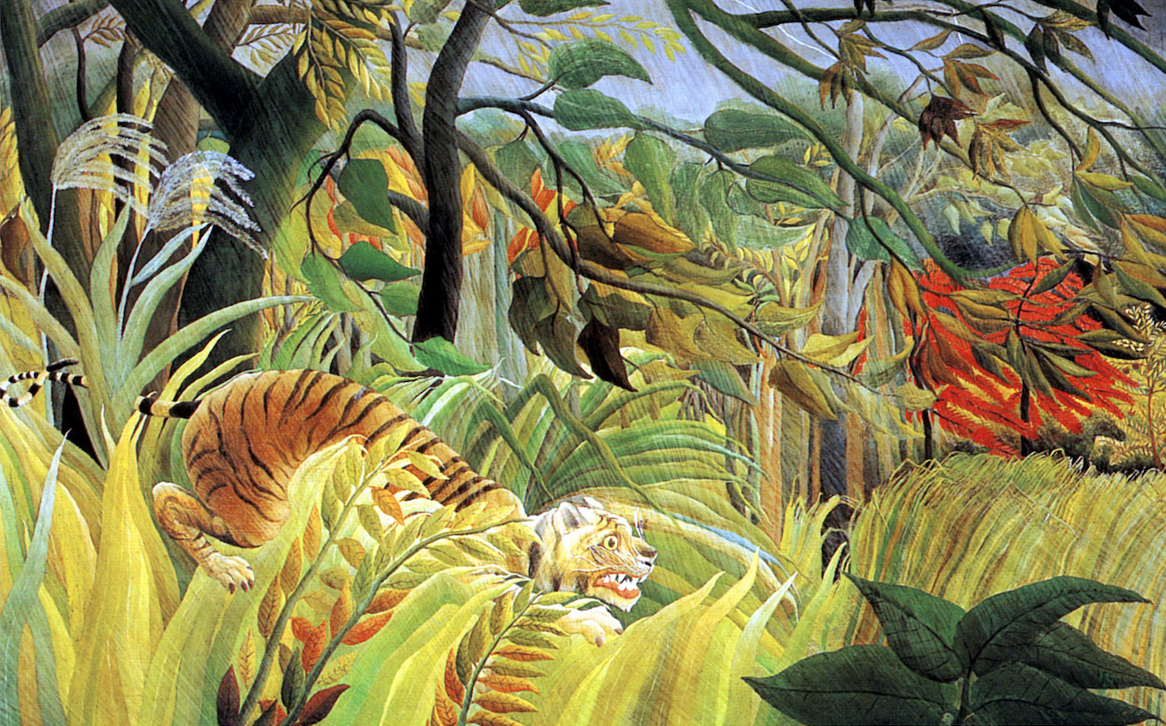

Slide 16
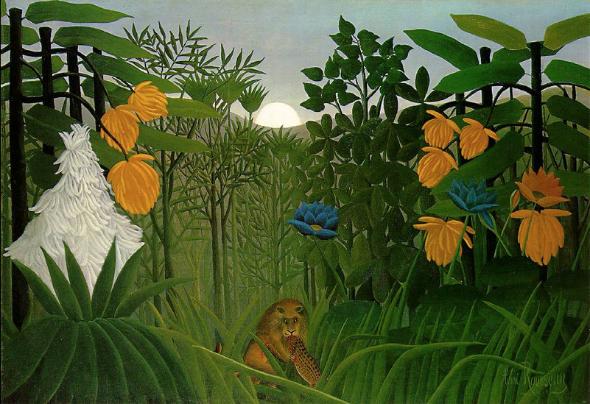
The Repast of the Lion, 1907

Slide 17
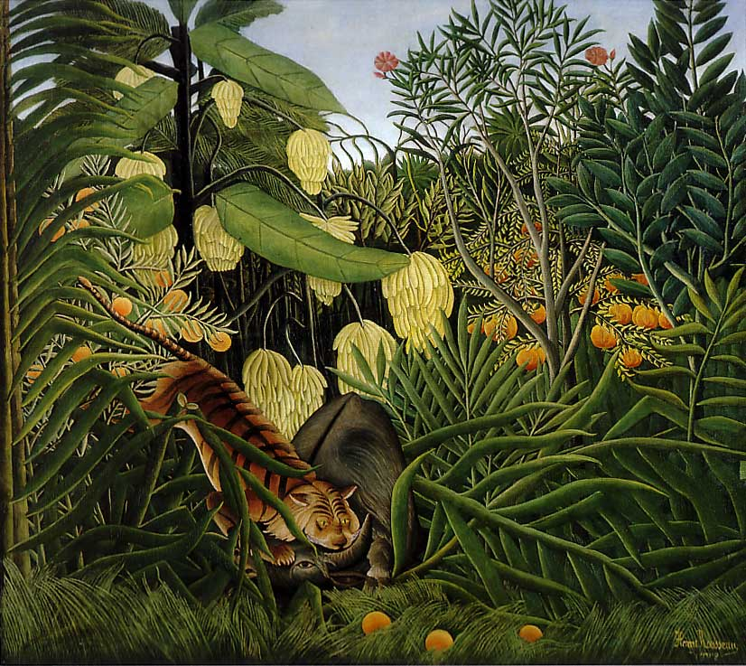
Combat of a Tiger and a Buffalo, 1909

Slide 18
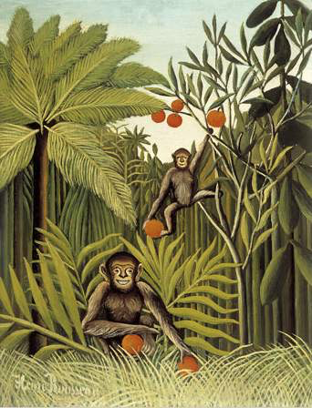
The Monkeys in a Jungle, 1909

