Slide 1
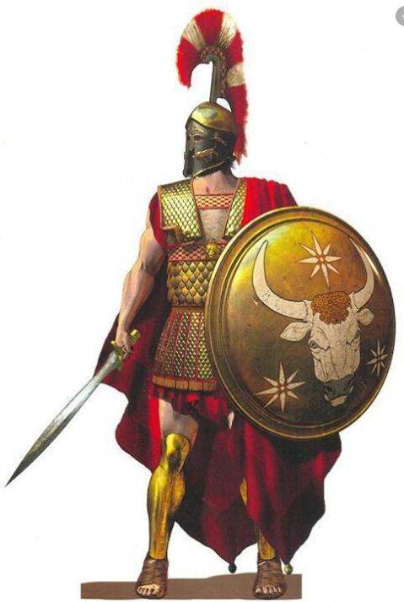
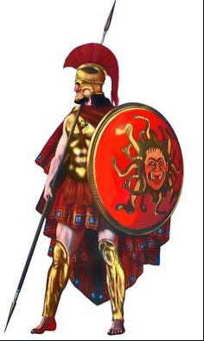
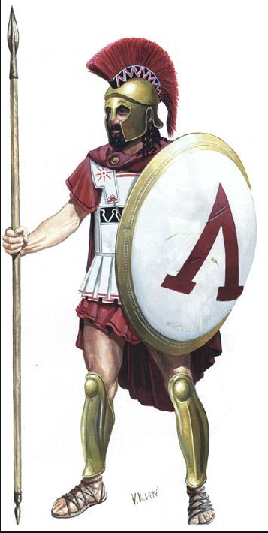
LO: To design a Greek shield.

Slide 2
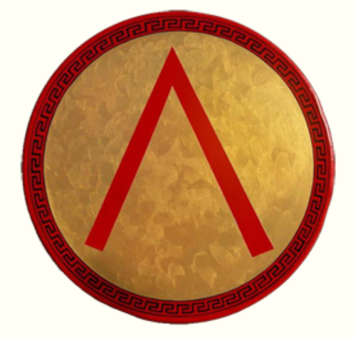
LO: To design a Greek shield.
Men, in ancient Greece, were expected to serve the army for at least 18-20 years in almost all city-states.
In some Greek city-states like Sparta, it was compulsory for all men to undergo rigorous training and join the army after they turned 20 years old. Training often started for boys at the age of 7!
One of the most important pieces of armour for the warriors was their shields.

Slide 3
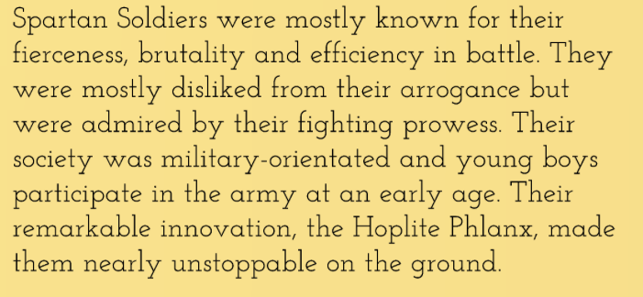
LO: To design a Greek shield.

Slide 4
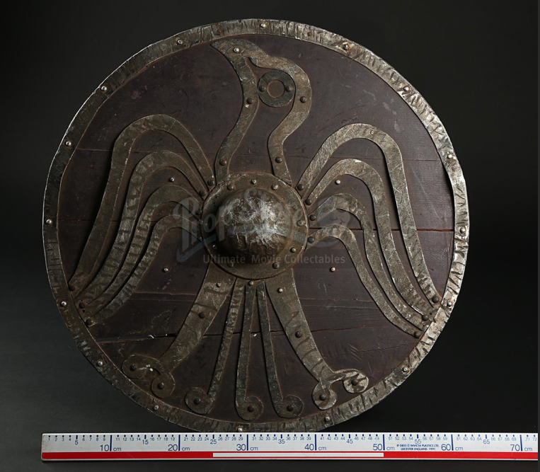
LO: To design a Greek shield.
Towards the end of the eighth century BC, the ancient Greeks invented a large, round shield (aspis) that was to dominate Greek warfare from that point onwards down the Hellenistic era.
It’s often referred to as an “Argive” shield.

Slide 5
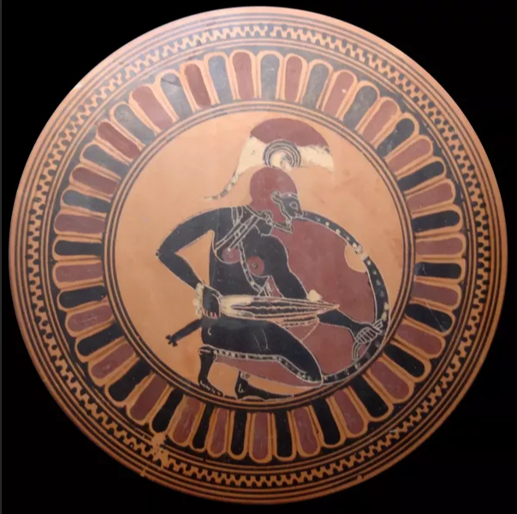
LO: To design a Greek shield.
The Argive shield was round, about a metre or more in diameter.
It was convex (“hollow”, as the ancient sources would have it), and featured a central arm grab (porpax) through which the left arm was put, while the hand grabbed a handle (antilabe) near the shield’s edge.
Often, there was another antilabe on the opposite edge, which perhaps served as a spare.

Slide 6
LO: To design a Greek shield.
The warrior would carry the Greek shield in his left hand with the help of a central band and a grip (a strap on the back of the shield).
Shields would weigh as much as 8kg sometimes and the fighter would require great strength and skill to use it as protection.
The entire armour chest piece and helmet, arm and leg guards (greaves) would sometimes weigh as much as 20kg!

Slide 7
LO: To design a Greek shield.
Shield Designs
The shields were either made of bronze (very heavy!) or wood which was covered with bronze. These were painted with different designs of which the mostly widely used was the Lambda – the inverted V-sign – and the Gorgon which came from Greek mythology.
It was believed that a person who saw the emblem of the Gorgon would turn into stone and so it was used on the shields to distract the enemies.

Slide 8
LO: To design a Greek shield.
Shield Designs
In other instances, shield blazons were connected to the owner of the shield, and therefore must have had some personal significance.
In some cases, the meaning might not be difficult to guess: a lion would symbolize strength and courage, for example, while a snake was a symbol of wisdom and immortality (because snakes sloughed off their skins at regular intervals, the ancient Greeks believed they continuously renewed themselves).

Slide 9
LO: To design a Greek shield.
Shield Designs
Sometimes the round shields would be as big as 80cm (or 30 inches) in diameter!
They would also be cut out into different shapes to make them light in weight and yet serve their primary purpose of protection.
HAVE A LOOK ON THE NEXT SLIDES FOR SOME SHIELD PATTERN EXAMPLES.

Slide 10
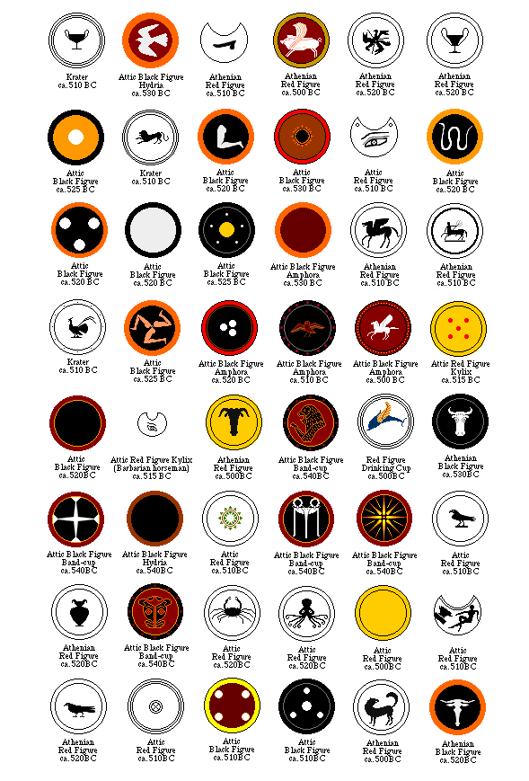
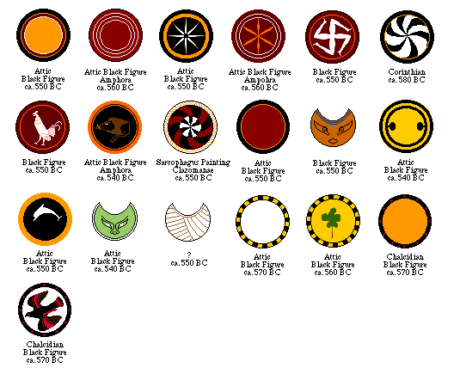
Shield Designs

Slide 11
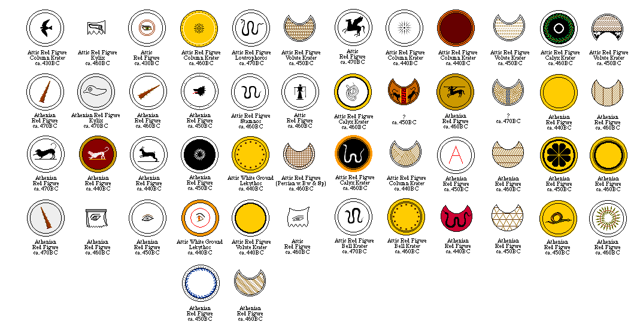
Shield Designs

Slide 12
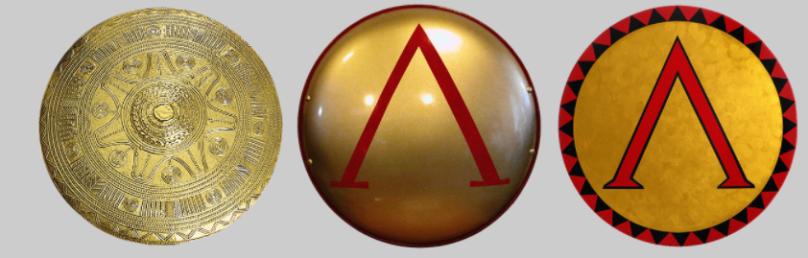
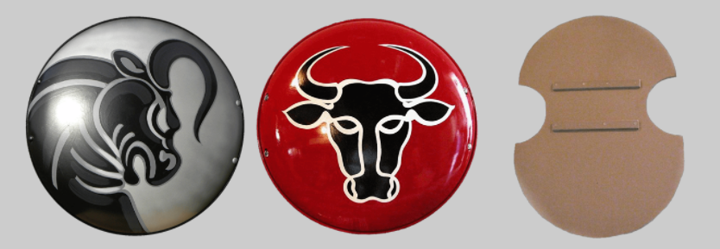
Shield Designs

Slide 13
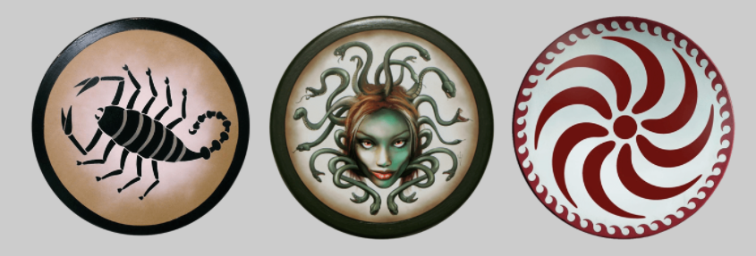
Shield Designs

Slide 14
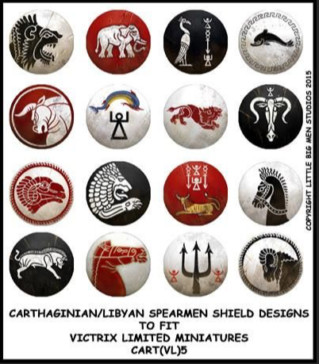
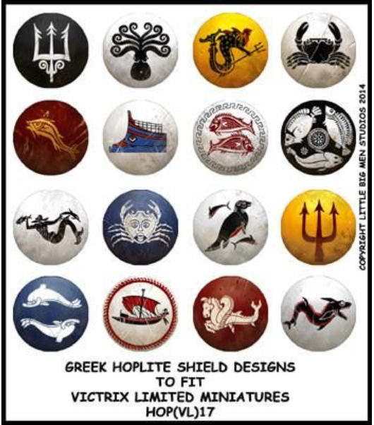
Shield Designs

Slide 15
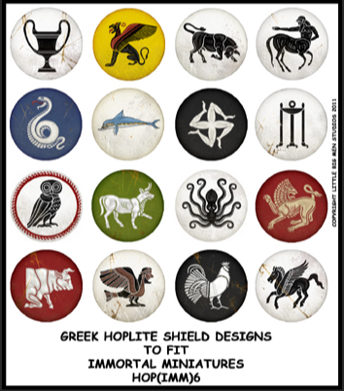
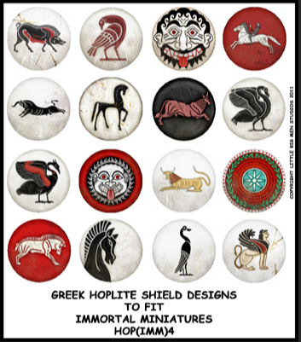
Shield Designs

Slide 16
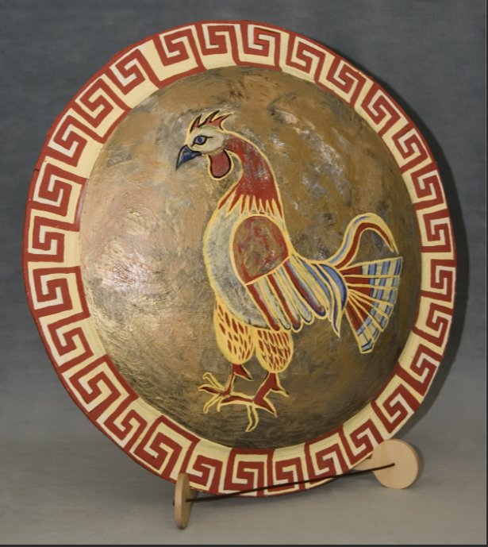
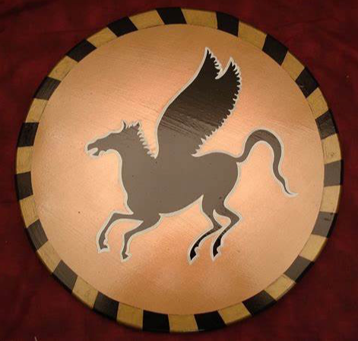
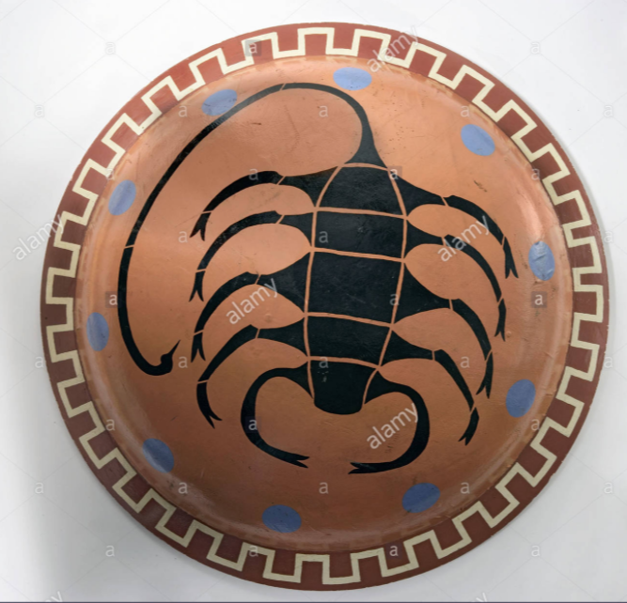
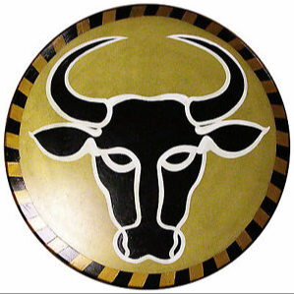
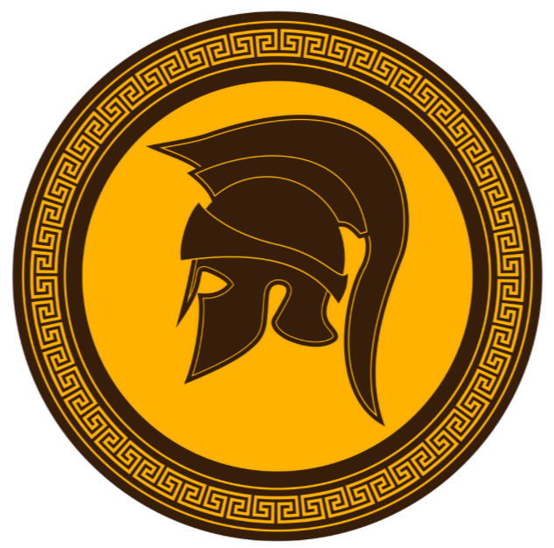
Shield Designs
Can you spot the geometric patterns around the edges of the shields?

Slide 17
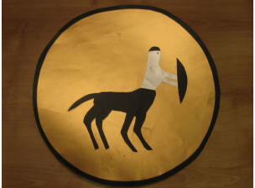
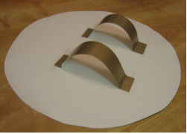
Indpendent Work
Now it’s your turn!
You should have taken some card home with you from school for this purpose.
First draw a large circle on a piece of cardboard - the easiest method is to draw around a suitable large container (a bin?!), or alternatively fasten a pencil to a length of string and use as a simple compass. Cut out the circle.
Many ancient Greek shields had a decorative border so you can either paint this or cut out another slightly larger circle from different coloured cardboard and glue the two together (this is the method we used).
Next decorate your shield  look at the examples, do your own research or take inspiration from Greek mythology.
Finally you need to be able to hold your shield easily. Cut out two strips of cardboard and attach to the back of your shield as shown in photo.
Make sure you take a picture of your finished shield and email it to your teachers via Purple Mash email or the School Office.

